Slide 1
LAC Update on ATIP
National Claims Research Directors Meeting
May 14, 2024
Ottawa, Ontario
Presented By: Kristina Lillico
Director General, ATIP Branch, LAC

Slide 2
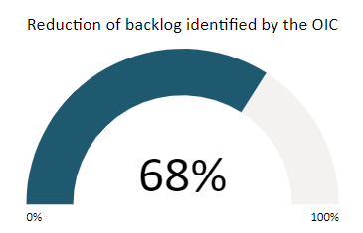
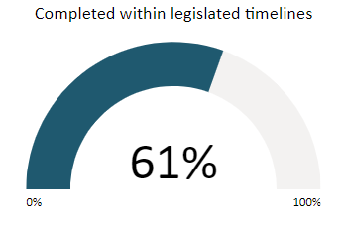
2023-24 LAC ATIP Results Achieved
8,492
Requests received
14,653
Requests completed
12,023
Requests carried forward to 2024-2025
1,599,495
Total pages reviewed

Slide 3
Formal Requests for Indigenous Related Records
2023-2024
Formal ATIP requests received: 189 + 147 requests carried forward from previous year
Formal requests closed: 275 (139,764 pages)
Overdue requests completed: 93 (29%)
Current number of requests in queue: 196
Number of outstanding overdue requests in queue: 102
Notes:
Includes formal ATI and Privacy Requests
LAC has begun tracking these requests differently since Fall 2023 to specifically isolate and identify requests for records processed by the Indigenous Records Team.
In 2023-24, LAC began more systematically taking appropriate extensions based on number of pages requested and complexity anticipated for the review.

Slide 4
Informal Requests pursuant to 8(2)(k)
Number of requests processed have increased in the past three years
 | 2021-2022 | 2022-2023 | 2023-2024
Received | 95 | 83 | 131
Closed | 5 | 40 | 72
Number of pages released | 10,321 | 38,780 | 61,956

Slide 5
Challenges
Volume of requests and the number of requests are increasing
One request for 30,000 pages and many for tens of thousands of pages
LAC is receiving 8(2)(k) requests where the request includes non-personal information, LAC will be looking to segregate these requests to ensure efficient processing by appropriate team
Recruitment of analysts, training/peer-review is a lengthy process
Litigations without added funding putting pressure on our regular operations output (ex: Day Schools and Mohawk Mothers)
Implementation of new procedures and systems
Onboarding to TBS ATIP Online portal, receiving more formal requests which become priority for processing
Reduce backlog of overdue requests (target for 2024-25 is 25%)
Notes:
LAC will be triaging differently upon receipt of request to ensure more efficient triage and segregation of types of requests for more efficient processing (separating 8(2)(k) from general requests for non-personal information.
This summer LAC may contact clients to discuss options for more efficient processing of requests currently in the queue, including advantages to formal requests.

Slide 6
Improvements and Opportunities
No fees for formal requests for Indigenous requesters/Indigenous related records
Added information to the 8(2)(k) forms and the LAC website
Digitization of new 8(2)(k) requests: reduced costs for clients, shortened timeframes for processing, client receives a digital package
Team in transition, more recruitment underway to increase capacity
3 new ATIP Analysts/Officers in this team by early June (Total 10!)
New triage processes
Redistribution of requests in two separate workflows for more efficient processing
Identification and segregation of requests for personal vs. non-personal information
Previously released formal ATI requests on archival records will be published on LAC’s website (June 2024) – going back approximately 10 years
Notes:
*If files already proceed and opened under other requests, this becomes a reprography request or in person consultation of paper files.

Slide 7
Conclusions and Next Steps
Team has grown, more requests processed, still more to do
Reduce and ultimately eliminate backlog of overdue requests
Implement new procedures and hire more employees
Continue more refined tracking of different request types to ensure better responsiveness
If you don’t require personal information, don’t submit under 8(2)(k)
Outreach to requesters, researchers and communities when necessary
Notes:
If you decide later the personal information is required, a subsequent 8(2)(k) request can be submitted (provide the reference to the previous request #) and LAC can process more quickly.

Slide 8
Contact information
Library and Archives Canada
550 de la Cité Boulevard Gatineau (Québec) J8T 0A7
Telephone: 613-996-5115 or 1-866-578-7777 TTY: 613-992-6969 or 1-866-299-1699 Fax: 613-995-6274
Our website: www.library-archives.canada.ca
National Capital Region
Vancouver British Columbia
Winnipeg Manitoba
Halifax Nova Scotia

