Slide 1
AFN-Canada Specific Claims Co-Development
National Claims Research Directors Meeting
May 14th, 2024

Slide 2
Overview
Background
AFN Mandate
Co Development Efforts
Current Status
Joint Discussion Paper
Outstanding Issues
Engagement
Questions/Discussion

Slide 3
Background
AFN planned and carried out a comprehensive engagement process in the fall of 2019 with First Nations nationally seeking input into what a fully independent specific claims process should look like.
This engagement led to the development of a draft AFN Proposal based on First Nations input and rigorous peer review.
The AFN published the finalized Proposal on the AFN website in May 2022.

Slide 4
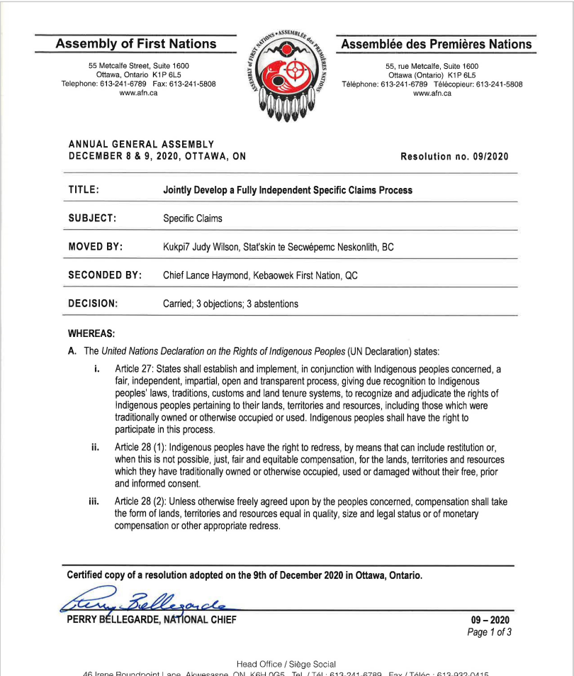
AFN Mandate
AFN Resolution 09/2020, Jointly Develop a Fully Independent Specific Claims Process directs the AFN to work jointly with Canada to develop a fully independent specific claims process consistent with the United Nations Declaration on the Rights of Indigenous Peoples and the following principles:
The Honour of the Crown
Full Independence of all Aspects of Claims Resolution
Recognition of Indigenous Laws
No Arbitrary Limits on Financial Compensation

Slide 5
Co Development Efforts
Cabinet Mandate
In July 2022, CIRNAC received a Cabinet Mandate to co-develop an independent centre for the resolution of specific claims with the AFN.
November 2022 Specific Claims Implementation Working Group (SCIWG) Launch
In November 2022, the AFN (with the Chiefs Committee on Lands and Resources) and CIRNAC (with then Minister Miller) held a public ceremony in Halifax, NS to formally establish the Specific Claims Implementation Working Group (SCIWG).
SCIWG Structure
Senior representatives from the AFN and the Specific Claims Branch.
Technical advisors
Principals: CCoLTR portfolio holder and CIRNAC Minister
The SCIWG Terms of Reference requires the AFN and SCB to report to the CCoLTR and the Minister of Crown-Indigenous Relations respectively.

Slide 6
Joint Discussion Paper
In February 2024, the SCIWG conducted a three-day co-development session with an independent facilitator to resolve issues and arrive at consensus to form a joint document for the purpose of consultation and engagement.
This led to the development of a discussion paper that describes the basic elements of a proposed design of the Centre for the Resolution of Specific Claims.

Slide 7
Joint Discussion Paper: Guiding Principles
Timeliness
Fairness
Independence: Canada will have no say in what decisions are made by the Centre. The Centre will be free from direct control or influence by Canada meaning, amongst other things, that how the Centre’s governance is structured, and how it performs all of its roles and functions, is “arms-length” from federal Ministers and Departments
to make the resolution of specific claims more effective and efficient, increase access to justice, and reduce the costs and consequences that have been too often experienced in the process of settling claims.
Recognition of Indigenous Laws: space for choosing to include information and evidence about Indigenous laws in developing and submitting a claim, bringing this information into the negotiations process, utilizing Indigenous methods of dispute resolution during the negotiations, and having these laws be considered in matters before the Tribunal

Slide 8
Joint Discussion Paper: Centre Functions
Registrar
First Nations will file the claim with the Registrar
Funding
provide funding to First Nations to research, develop and pursue their claims through all aspects of claims resolution
Resource Hub
serve as a central repository for research materials, assist with access to information, and offer support and capacity building for First Nations, including best practices for research and training.
Dispute Resolution Services
facilitate access to fair, just, and timely resolution of claims by providing expert dispute resolution services whenever necessary to help parties reach a negotiated settlement of specific claims
Specific Claims Tribunal
facilitate access to adjudication through the Specific Claims Tribunal.

Slide 9
Joint Discussion Paper: Claims Process
Within 6-8 months of receiving a claim, the Centre will facilitate a mandatory meeting of the parties to provide space for discussion of the claim and its history, identify outstanding issues, and for Canada to ask further questions before arriving at a position on lawful obligation.
After two years (instead of the current three years ) of review by Canada, a First Nation may file the claim with the Specific Claims Tribunal (the Tribunal), if Canada has not agreed to negotiate.
Access to facilitation and mediation services by the Centre while negotiating resolution of a claim
At any point in time if a First Nation feels there will not be a negotiated resolution of the claim, the Centre may be engaged to determine whether to refer the claim to the Tribunal.

Slide 10
Outstanding Issues
While the discussion paper identifies the core elements of the Centre, it does not specify every detail that may necessarily be the subject of engagement and dialogue.
There remain outstanding issues that are under discussion between the AFN and Canada, including the current $150 million dollar limit on compensation that may be awarded by the Specific Claims Tribunal, and the definition of who may bring a claim within the meaning of Specific Claims policy and process.

Slide 11
Engagement
The AFN continues to actively seek opportunities to engage with First Nations, regional organizations, and other interested parties.
The final design of the Centre will be informed by the perspectives and feedback shared by First Nations during the engagement process.

Slide 12
Next Steps
Engagement and continued joint development of Centre proposal.
Review of proposal by First Nations-in-Assembly and Federal Cabinet.
Joint drafting of legislation and implementation.

Slide 13
Questions & Discussion

