Slide 1
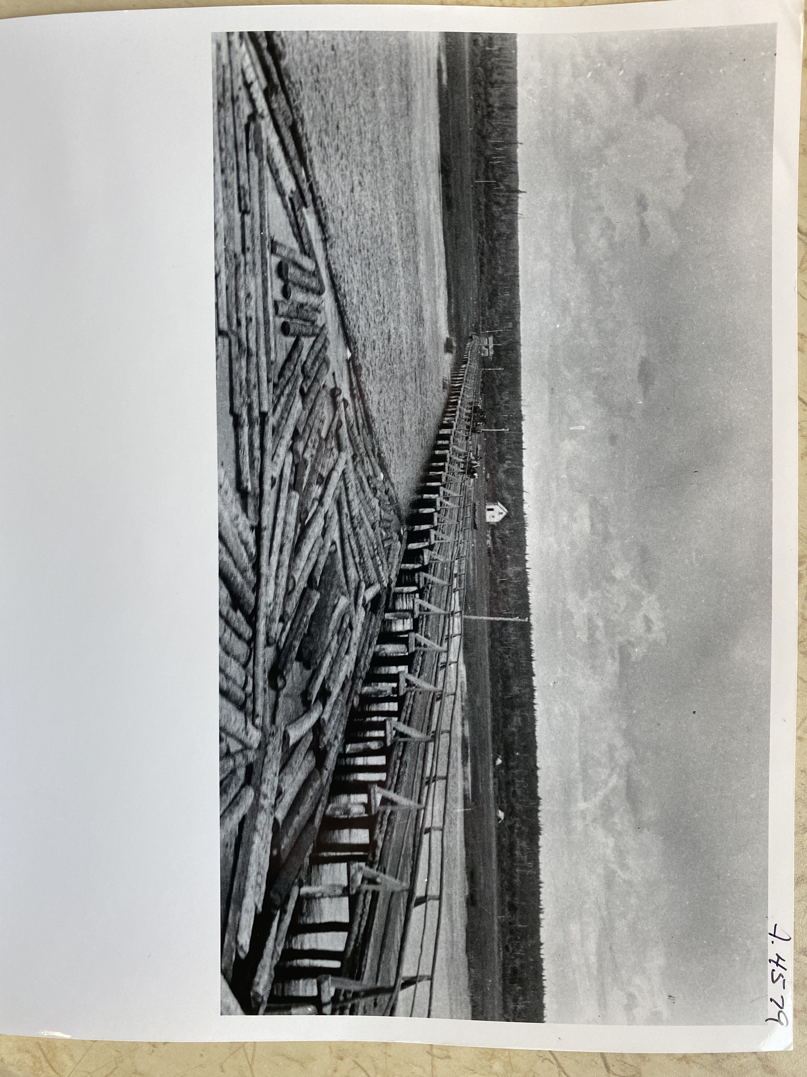
Images in Specific Claims
A Visual Approach to Research
Alexa Heenan National Claims Research Workshop 6 November 2024
Notes:
Hi everyone, I’m Alexa Heenan and I’m the research coordinator at Havlik Consulting Group where I’ve been a researcher for almost 5 years now.
Today I’m presenting on Images in Specific Claims as a visual approach to research

Slide 2
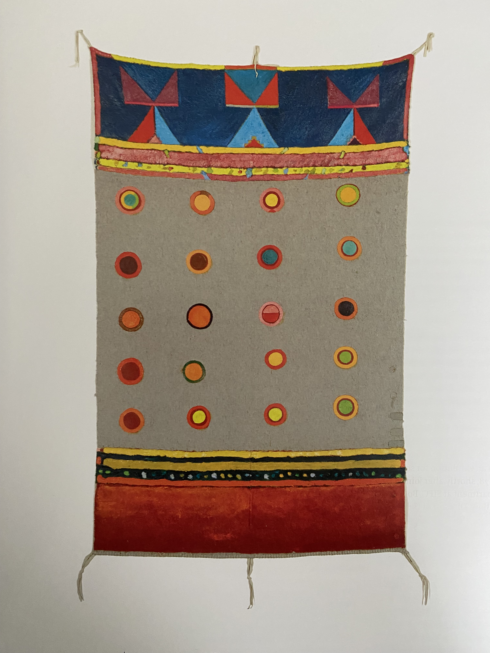
Introduction: Journey into Specific Claims
Background in Art History & Visual Studies, History, and Cultures of Display
Visual learner – gained knowledge of Indigenous cultures through art, objects, & photographs
Specific Claims combined my interests in research and Indigenous history
Bob Boyer, A Smallpox Issue, 1983.
Notes:
Like many of you here probably, I came into specific claims by chance
Here was a job that combined my interests in research and Indigenous history, but I really didn’t know what I was getting myself into because I was coming from the art world
I’d never heard of a specific claim, and didn’t know what they were, so this was all very new to me
But as we all know, Specific Claims is a very niche career where we might bring our experience in research, ability to ask questions and eye for detail, but a lot of the learning happens on the job.
Now, I’ve been incredibly lucky to have a great team of leaders and researchers to learn from and work with at HCG and what I love most is the different skills sets and backgrounds that we all bring to the Specific Claims process.
The background that I bring to the team and to you today is one in art history and visual studies
Now, I’m sure you are all probably asking yourselves, how does this skillset apply to Specific Claims?
First and foremost, I’m a visual learner and an art history degree taught me to understand history visually and seek information through a different approach
Having the ability to read and analyze an image provides an alternative lens through which to understand various cultures, histories, experiences, world views, and the list goes on.
For example, we can learn a lot about Indigenous history and colonial history through contemporary Indigenous art.
This is a work by Metis artist Bob Boyer called ”A Smallpox Issue” and it belongs to a series of works painted on blankets.
Now we often read about the horrific smallpox epidemics that swept through Indigenous communities and decimated populations
But to see it portrayed as Boyer does here is another way of learning, processing and understanding the devastating impact of colonialism upon Indigenous peoples
Boyer and his works really opened up a new door for me when it came to new ways of learning about history, especially through an Indigenous lens
However, when I did my Masters in art history, I turned my attention to Indigenous representation in historical and contemporary photographs

Slide 3
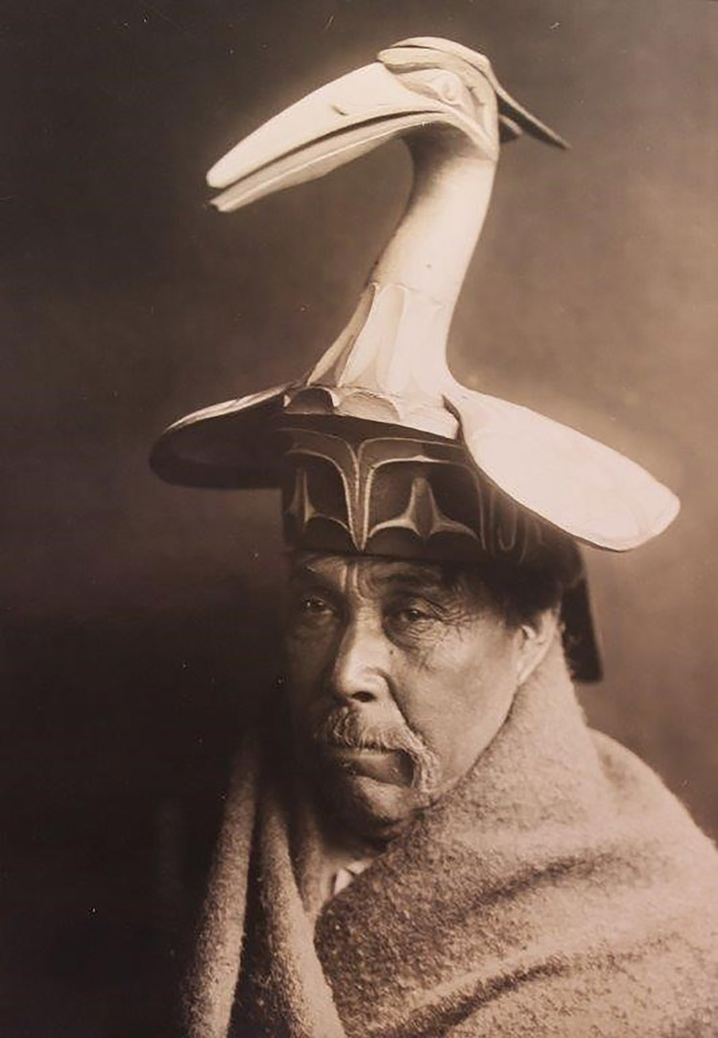
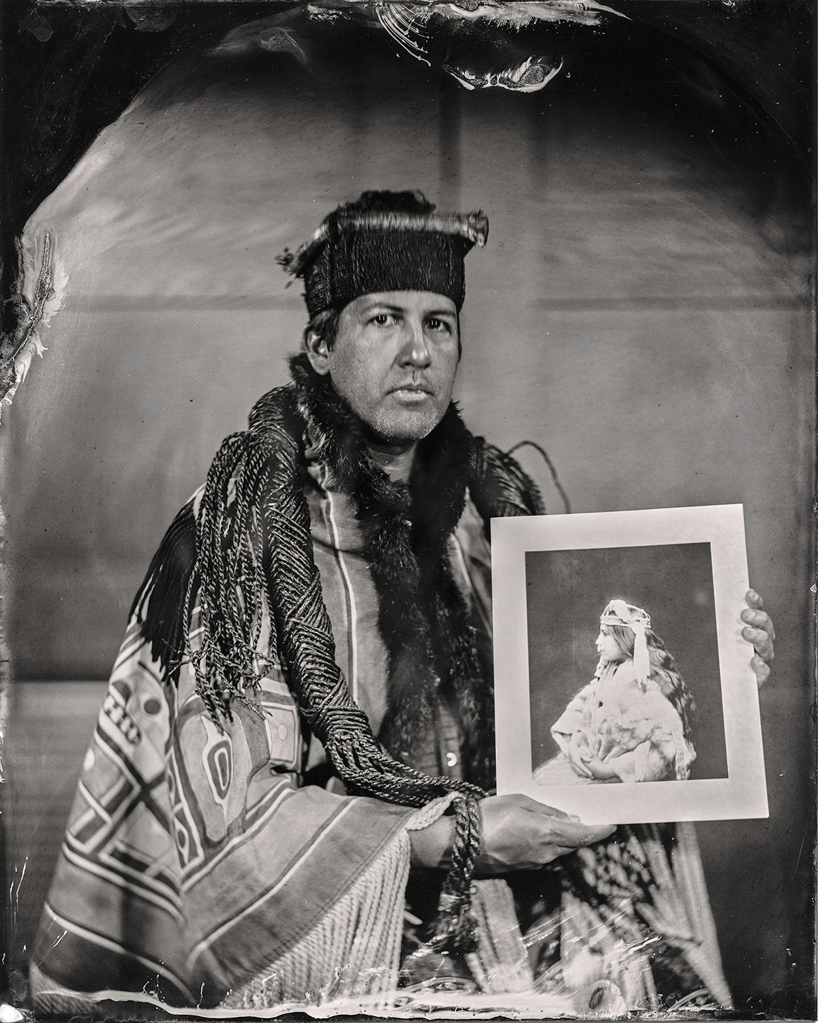
Edward S. Curtis, Man with Heron Hat, 1914.
Will Wilson, Talking Tintype, Andy Everson, Artist, Citizen of the K’ómoks First Nation, 2017.
Notes:
So here we have a historical photograph on the left Titled “Man with Heron Hat” by Edward Curtis and a contemporary photograph done is a historical style in on the right of Andy Everson of the K'ómoks First Nation
Now, I’ve chosen the work on the left to link back to the previous presentations we’ve just seen and listened to as an example of another way of understanding and representing Indigenous laws
At first glance the image on the left is a beautiful documentation of this ceremonial headpiece that we can see has been carved.
However, when Kwakwaka'wakw artist Marianne Nicholson spoke about this image, she revealed the significance and meaning behind this work.
Nicholson identified this man as Master Carver Chief Herbert Johnson and spoke to the creation of the hat for ceremonial use which relates back to land rights and the relationships to the land that is passed down from generation to generation as a hereditary right to harvest
Therefore, Herbert Johnson had the hereditary right to create this piece but also to wear it and it would have shown a particular relationship to a story, that then would have related to a place or a location in the land
And this hat has all of this symbolism carved into it and when he wore it he displayed all of that.
Lastly, Nicholson goes on to state that in a way the hat itself is a legal text.
Today under modern systems we write these things down but through Indigenous Law, the wearing of that hat, the creation, the witnessing and the approval of that hat is a legal process in itself.
I’ve also included here a photograph taken by contemporary Dine Photographer Will Wilson of Andy Everson of the K'ómoks First Nation who holds a photograph taken by Curtis of his grandmother as a reminder of how recent the history of these images are
My fascination and curiosity around historical photographs and the meaning that can be found within them has seeped into my approach to Specific Claims

Slide 4
Visual Approach
Specific Claims are centered around textual evidence
New technology allows for new ways of visualizing a claim
ex: drone, video footage & GIS mapping used by NNTC
Images provide an alternative source of information
Notes:
As we are all very aware, Specific Claims are centered around textual evidence like government correspondence.
I remember reading my first Specific Claim and asking myself “ where are the images?” Where can I breathe and take a break within this report?
I was inspired to do this presentation ever since the team at NNTC presented on the use of drone footage two years back and again last year on the use of drone, video footage and GIS mapping in their specific claims.
So shoutout to Shannon Williams, Serena Hunsbedt, and Jenny Donlan at NNTC!
Now, what’s great about images is that they provide an alternative way of understanding but also a new source of information that we can turn to as researchers when faced with roadblocks in the textual evidence

Slide 5
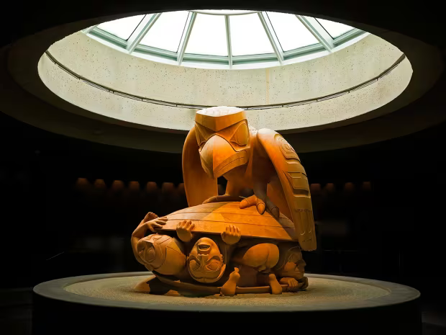
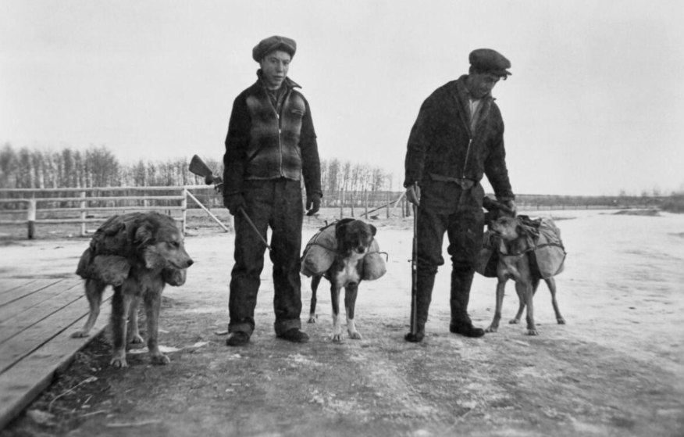
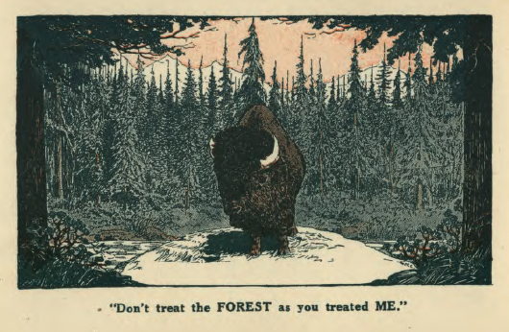
What is an Image?
An image is a visual representation
Art
Craft
Cartoons
Marketing
Maps
Surveys
Field books
Objects
Film
Photographs
Bill Reid, Raven and the First Men, 1980, MOA.
Cree packing fur, n.d., Glenbow Library and Archives
LAC, 1920s Game Act Publication, RG85, Vol. 1213, File 400-2-3, pt. 1.
Notes:
Now, speaking of a visual approach, lets step back for a quick second and first ask, what is an image?
By definition, an image is a visual representation that can be two dimensional like a photograph or three dimensional like a sculpture
Here we have examples of a photograph of two Cree men packing fur
We have Haida artist Bill Reid’s monumental carving titled Raven and the First Man which depicts the story of human creation according to Haida legend.
And lastly, a print from a 1920s Game Act publication where we see text play with an image as it states, “Don’t treat the Forest as you treated ME” and they use the image of the buffalo as a stark reminder of what happened with the buffalo

Slide 6
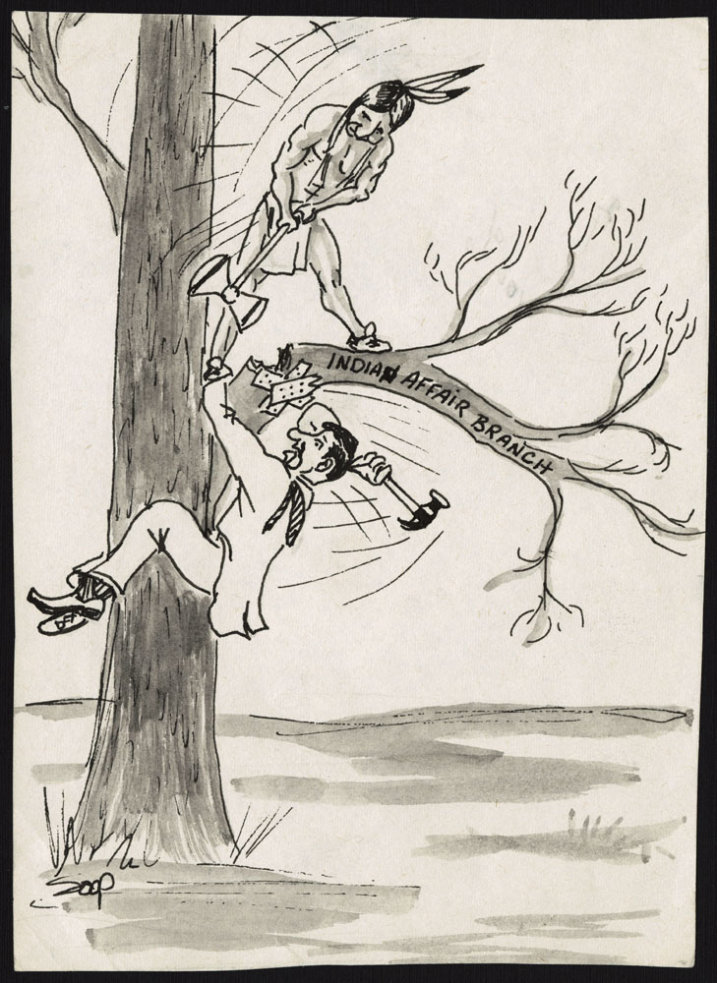
What Does an Image Say?
It can be different for everyone, but people with shared experiences, knowledge, & world views may have a similar understanding
An image reflects its maker, time, place, values, etc.
Everett Soop (Kainai First Nations), Indian Affair Branch, March 1969, LAC, Box 1280.
Notes:
So what does an image say?
When looking at an image we all bring our own experiences to our understanding and reading of it
However, something that is always constant is that an image reflects its maker, time, place, values, etc.
Here we have an example of a political cartoon that might not resonate with the average person that’s removed from politics and Indigenous issues
However, I’m sure this cartoon by Everette Soop of the Kainai (gaynah) First Nation, speaks to most of us here in this room and the constant battle we all face
I know I had a good chuckle when I came across this

Slide 7
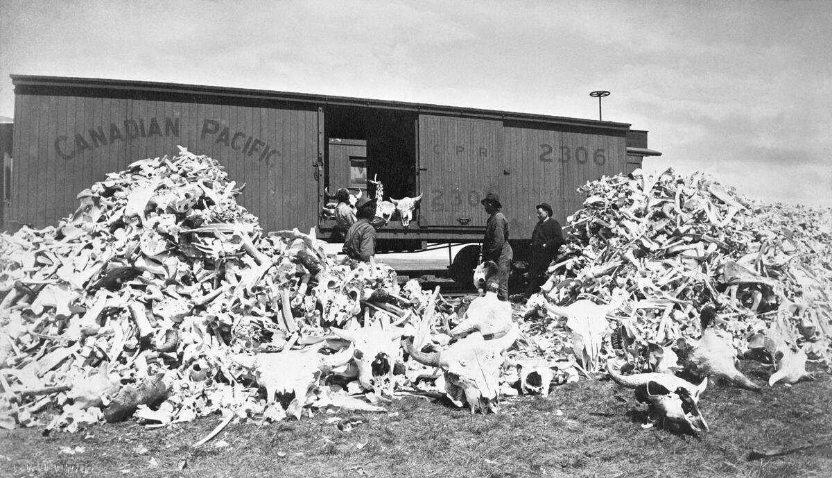
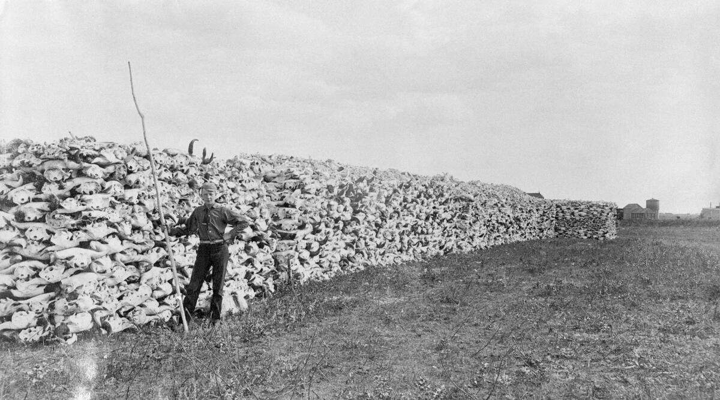
Why Include Images in Specific Claims?
Paint a picture / provide context
Bring people, places, & events to life
Help fill information gaps
Top: Buell, O. B., Buffalo bones ready for loading on Canadian Pacific Railway boxcar, Moose Jaw, Saskatchewan, ca. 1887-1889, (CU1124759), Glenbow Library and Archives Collection.
Bottom: Lumsden, H. C. E., Piles of buffalo skulls at the railway siding, at Saskatoon, Saskatchewan, 1890-08-09, (CU196815) Glenbow Library and Archives Collection.
Notes:
Now the big question is why should we include images in specific claims?
Images are of course a great way to help paint a picture of the events, places, and people that we are describing in our research reports and brings them to life
For example, you might turn to images like I have here on the screen when speaking of the slaughter and disappearance of the buffalo on the plains which directly impacted the livelihood of Indigenous peoples who depended on the buffalo for their survival
This disappearance of the buffalo led to treaty negotiations as First Nations were facing starvation and various colonial policies that were sweeping in with settlers in their traditional territories
So Images like these provide visual evidence of the decimation of the buffalo as bones littered the landscape and later collected, stacked and loaded into train carts for shipment to the states to be made into fertilizer for the emerging agricultural activities on the prairies.
Although its nice to paint a picture with images, sometimes images can actually serve as evidence themselves and help fill information gaps where textual evidence is sparse
This requires approaching images critically and exploring their context to reveal information
Don’t just take an image at face value
Often, this means actively seeking out related images and identifying information and texts on the subject to broaden one’s understanding beyond the original context where the image was first encountered.
This is especially true for titles and labels given to images in secondary sources or in various archives that have the same image.
"Buffalo bones ready for loading on Canadian Pacific Railway boxcar, Moose Jaw, Saskatchewan.", [ca. 1887-1889], (CU1124759) by Buell, O. B.. Courtesy of Glenbow Library and Archives Collection, Libraries and Cultural Resources Digital Collections, University of Calgary.

Slide 8
Images in Specific Claims Example: Bridge & Road Trespass
Government Correspondence
Indian Agent Sketch
Nation informed us of a bridge that crossed from their reserve to a small town on the north shore
There is a current bridge built beside an existing bridge
Nation spoke of a bridge before these two
How do we find the location of this original bridge?!
Bridge Announcements
Newspapers
Surveys
Labeled old bridge
Location of approach roads
Maps
Photographs
Support its existence
Notes:
Now to bring everything I’ve been talking about full circle I have an example of a claim where images played an important role in filling information gaps when I was struggling to find evidence in the textual records.
This claim delt with the trespass of three bridges and various road iterations that approach the bridges which passed through a Nation’s reserve
I’ll be focusing today on the bridge aspect of the trespass
Now, the Nation informed us of a bridge that crossed from the reserve on the south shore to a small town on the north shore of a body of water
Currently, there is a bridge that’s in use that was built beside the old bridge
However, plot twist, the Nation spoke of a bridge that existed before these two!
So now we are asking ourselves, how do we find the location of this original bridge and did it really exist at a time when it would be considered as trespass on the Nations reserve
Of course our first instinct was to look at government records and correspondence where we found nothing until we happened across a sketch done by the Indian Agent where he drew the reserve and the location of the bridge and the roads in relation to two buildings that he was referring to in his letter
This sketch was our biggest piece of evidence because it provided a location and a date when the bridge existed
We also looked at newspapers where spoke of the original bridged and that it was destroyed and rebuilt in a new location which is where we see the bridge today
We had so many federal and provincial survey maps that needed to be pieced together because they never quite revealed all the information
However, we did finally find one survey that labeled the location of the old and new bridge
Google maps came in handy because we could overlay the Indian Agent’s sketch with Google maps and it gave a pretty accurate location of the original bridge and we could then look for evidence in the landscape of the bridge
And lastly, I looked at photographs to support the existence of this original bridge

Slide 9
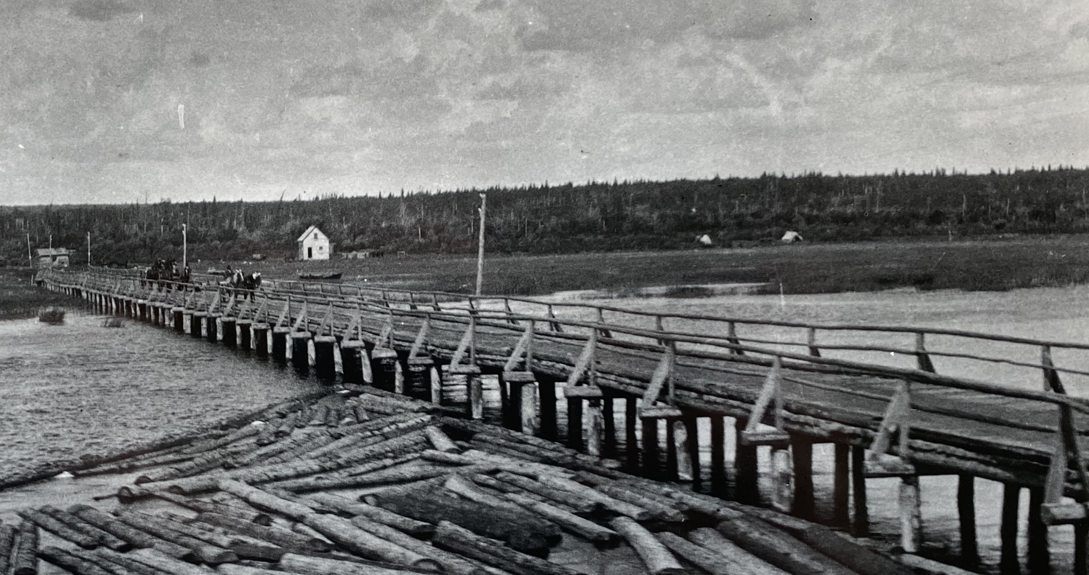
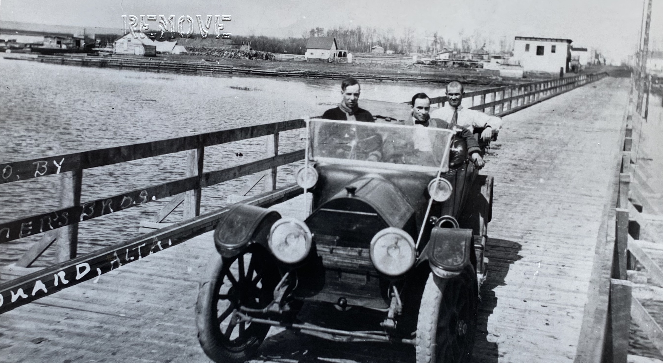
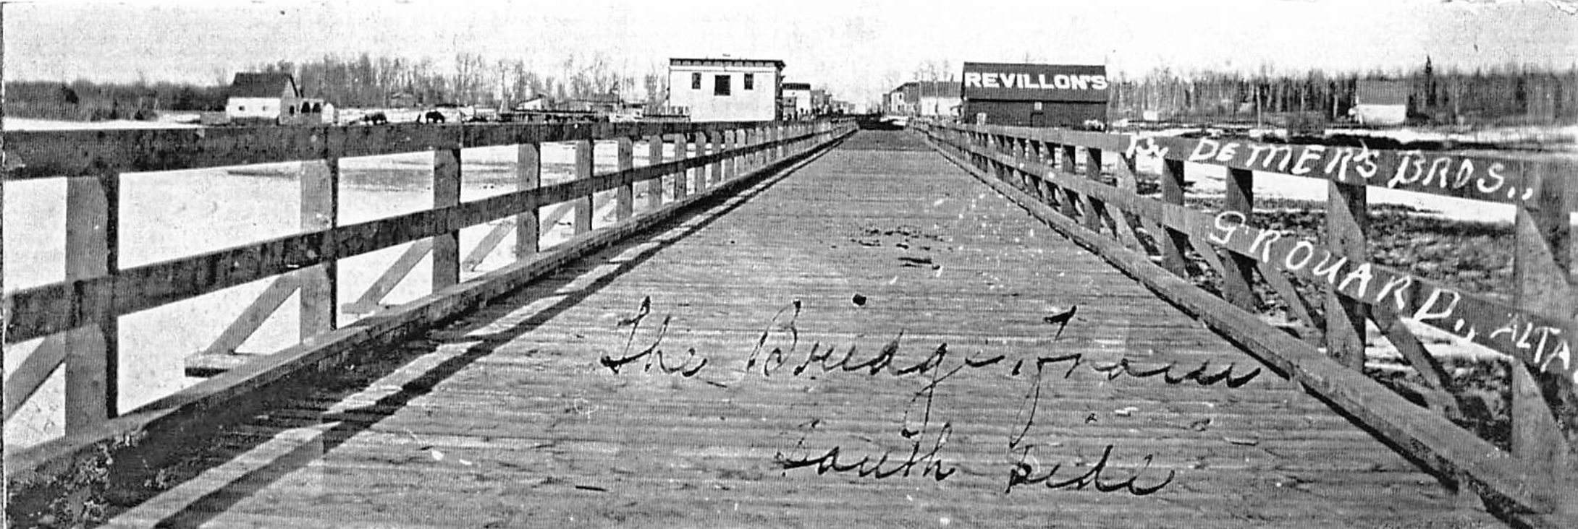
Notes:
Images really helped bridge gaps where little textual evidence existed and helped create a cohesive history from the first bridge to the second where we were really struggling to find exact dates and location
Finding images like we have here validated this history
Be aware though that dates and titles given to images aren’t always accurate.
This is why you should always compare images, research the context around the image, and do a visual analysis
For example, I was able to say with confidence that the top left image is the first bridge based on the Indian Agent’s sketch which mentioned the two buildings that we see in the background
The photo on the right, however, was labeled 1910 and I knew from my research of the second bridge that it connected to main street and the buildings behind the car were the buildings on main street and we had other images of the second bridge with the right date with those same buildings so I could safely say that the image was not from 1910 but 1914

Slide 10
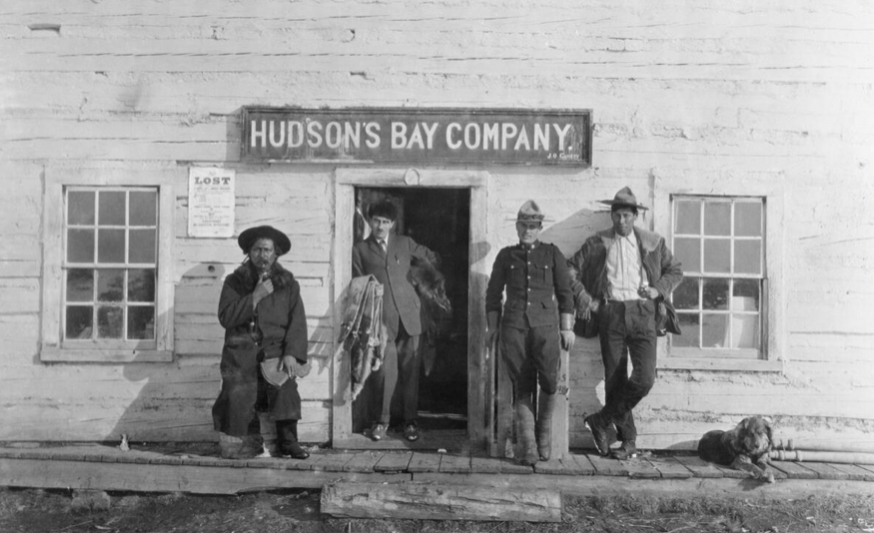
Benefits of Using Images in Specific Claims
Alternate source of information
Evidence to support textual records
Help conduct visual analysis
Connect the past with the present within the community
When sharing images with community, it sparks stories!
Byron-May Company Limited, Hudson's Bay Company post, Alberta, ca. 1914-1916, Glenbow Library and Archives Collection.
Notes:
So, there are several benefits to using images in Specific Claims
As we’ve just seen, images can be an alternate source of information when we run into roadblocks with textual evidence
They can support textual evidence by helping visualize something we are talking about
They allow us conduct a visual analysis
They also connect the past to the present when we bring these images into community
I actually presented on the bridge claim I shared with you completed through images which was really fun
And by doing this we can spark some really great stories with members that can sometimes lead to other claims

Slide 11
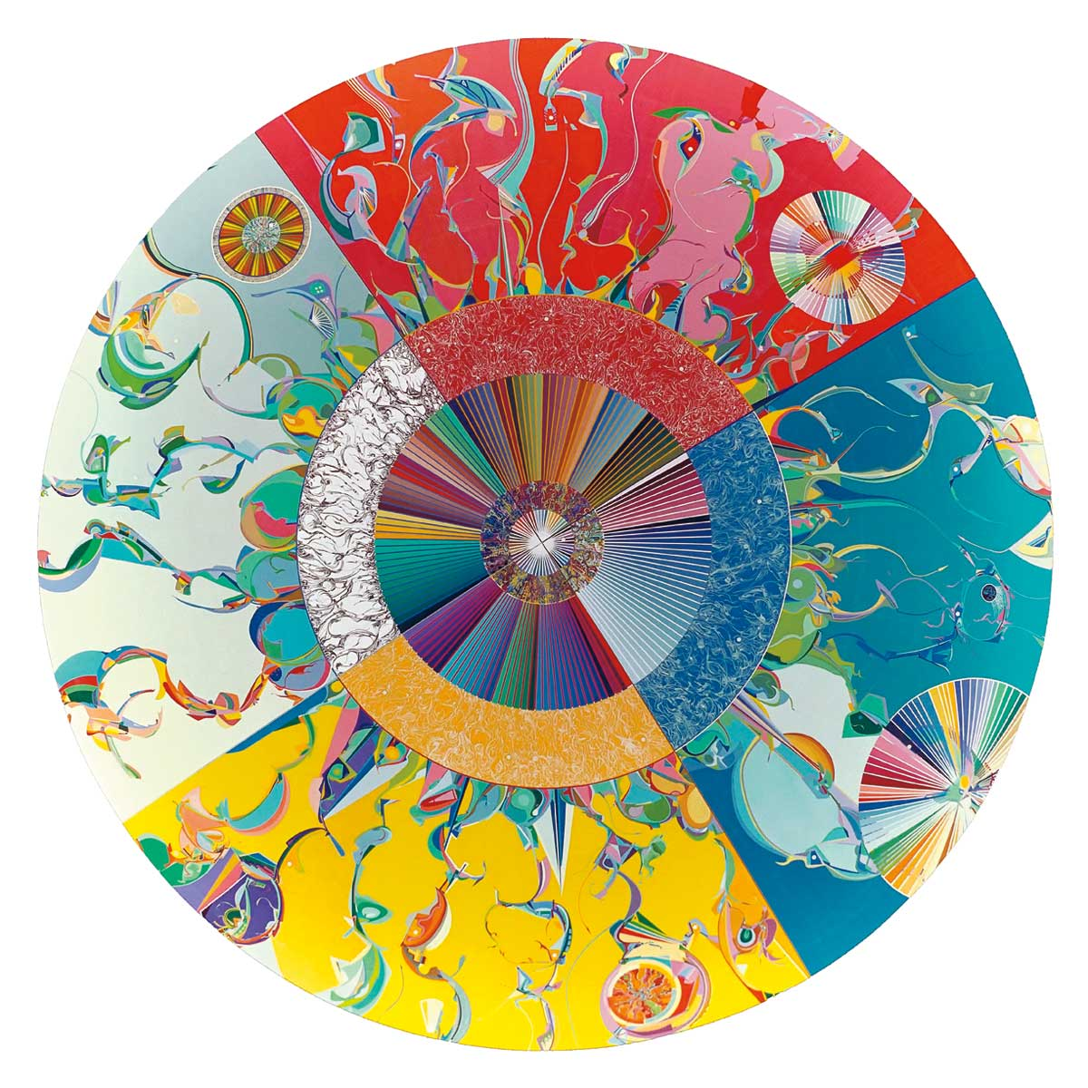
Take away
Be creative!
When you encounter a textual roadblock, try looking at images
Get to know other researchers at this conference and find out what skills they bring to Specific Claims
Alex Janvier, Morning Star, 1993. (Canadian Museum of History)
Notes:
So I have three big take aways for you
One, be creative in you research
Two, when encountering a roadblock in textual evidence, try looking at images as a source of information
Three, now that you’ve learned about my skill, take the time at this conference to get to know other researchers and find out what skills they bring to Specific Claims because we are all here to learn from each other

