Slide 1
Transcription 101: AKA: How to read and transcribe terrible handwriting
Morgan Chapman
Managing Partner, Research
National Claims Research Workshop | Gatineau/Ottawa | November 6, 2024
Notes:
The catalyst for this presentation was some conversations we ended up having at last year’s conference around transcriptions. We ended up workshopping some of our own unique best practices live in the room – and when we came to plan this year’s workshop, this seemed like a great practical session we could hold.
A bit of background about me – I was hired by HCG on the heels of the mass-rejection of claims for minimum standard issues, and my first goal? Transcribe the literal HUNDREDS of documents and (I would guess) near a thousand pages of handwriting.
How did I do it? I have my own terrible handwriting (which you are about to see), and that of my father, to thank!

Slide 2
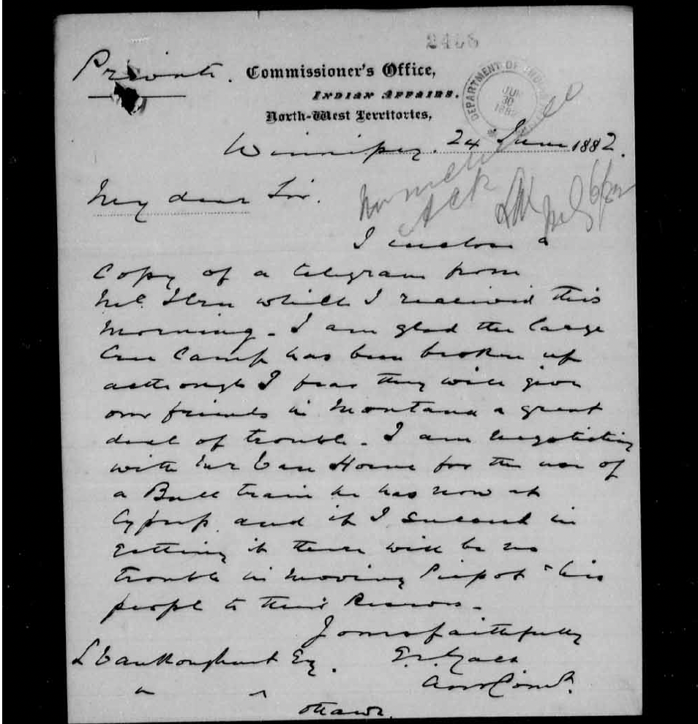
What we’re starting with…
This is a pretty messy document
A few easy to see words and letters
A document I do not know much about – context/knowledge of the record does help you transcribe it!
Only one page – phew!
Notes:
My team found this open document online at LAC and told me to “do my worst” – for today’s purposes this was it.
Luckily this is a short document (only one page) but that poses its own set of challenges as there are fewer words to figure out and help us later in the process.

Slide 3
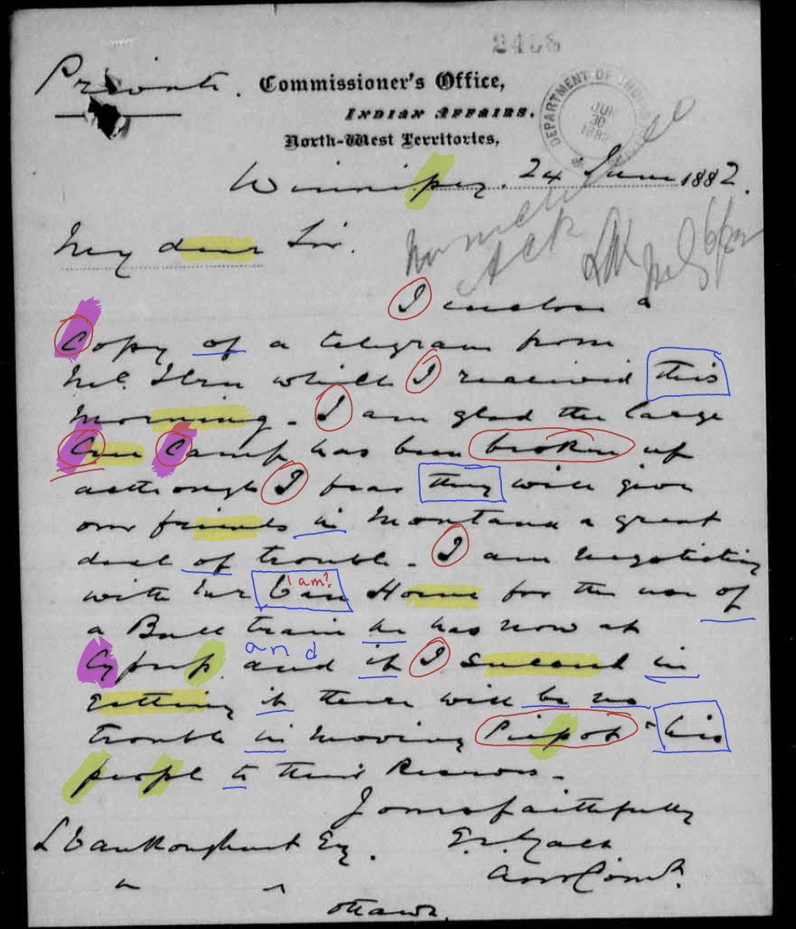
First Steps
Identify the letters or words you can clearly see – this will allow you to focus on the words or phrases that are more difficult
Can you identify troublesome letters or words that repeat in the document?
f, b and p can often look alike
This writer “falls off” with a lot of his words (yellow)
What type of language is key for the time that might help you identify letters?
“Faithfully yours”
”I have the honour to be, your obedient servant”
“My dear Sir,”
My dear Sir,
faithfully

Slide 4
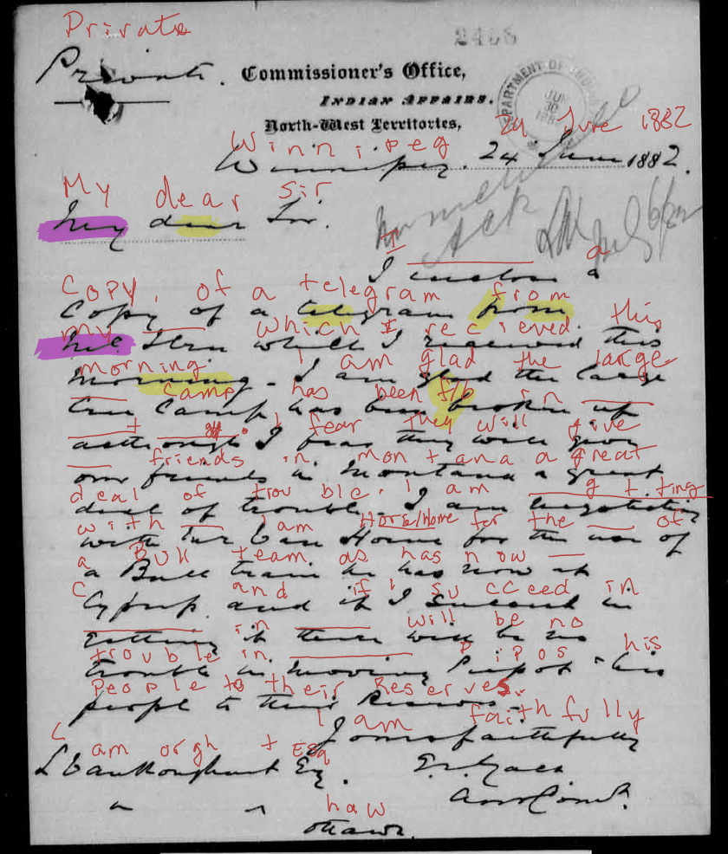
Start to build your transcript!
Use tools that are available to you. Don’t forget:
Print your documents and write out what you see on the physical copy!
ZOOM IN!
Use context clues!
Use different colour pens to correct yourself!
Notes:
When I first started doing transcriptions, tougher documents like this would get the printer treatment – I’d grab a whole load of coloured pens and start making notes above each word – picking out individual letters I could make out, full words when possible and eventually I’d end up with something along the lines of this…

Slide 5
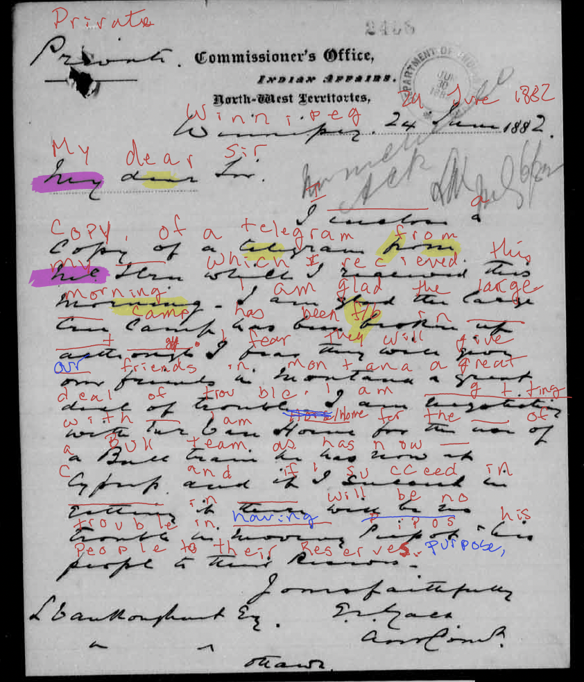
Notes:
Once you have a decent amount of the document transcribed, read what you’ve identified – use a different coloured pen to fill in words that now might make sense given the context of the letter. This may happen when you start to type out your own notes into something resembling the original…

Slide 6
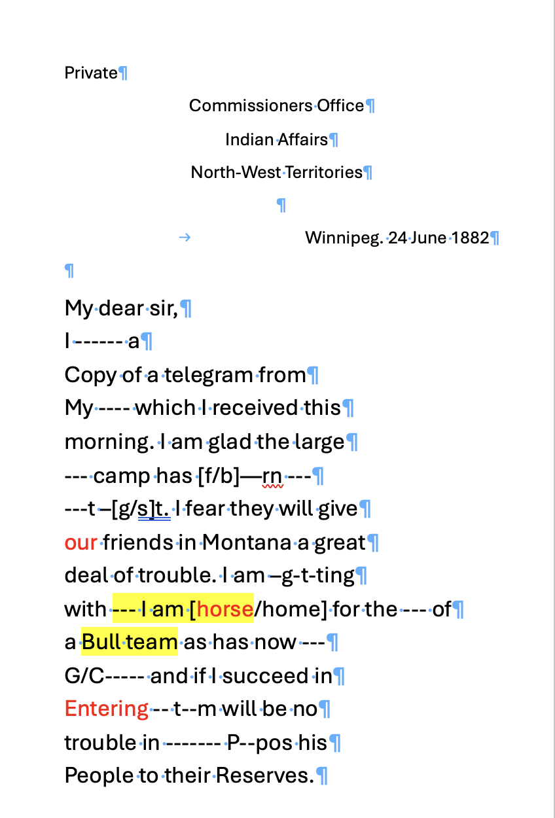
Where does that get us?
To something that looks a little like this!
My text in red are examples of words that became easier to tell once I started typing my previous scribbles out.
Your brain is a powerful tool – it will start to predict the next words based on what you typed previously – use that to your advantage.
Be prepared to edit – what you see on paper originally may not be 100% accurate…
Look for themes in the writing – what are they talking about?
Notes:
The text I’ve highlighted in yellow may make sense, but it also doesn’t necessarily work in the overall context. I’m still missing key words and phrases earlier in the letter.
What I do see:
Possible talks about farming? If they’re worried about having horses in place of bull teams that could relate to on-reserve agricultural efforts
Looking at the last sentence, there is clearly an issue with having the First Nation discussed in this letter settle on-reserve. Securing livestock to help the Nation develop the reserve would make sense in possibly convincing people to return and settle on-reserve.
What else do you see?

Slide 7
Let’s go finish the transcript…
Notes:
Now that I’ve explained a few of the ways I break down my transcription projects, lets go back to the original document and see what else we can solve.

