Slide 1
Hudson’s Bay Company Archives
The Hudson’s Bay Company and the Administration of Land After 1870

Slide 2
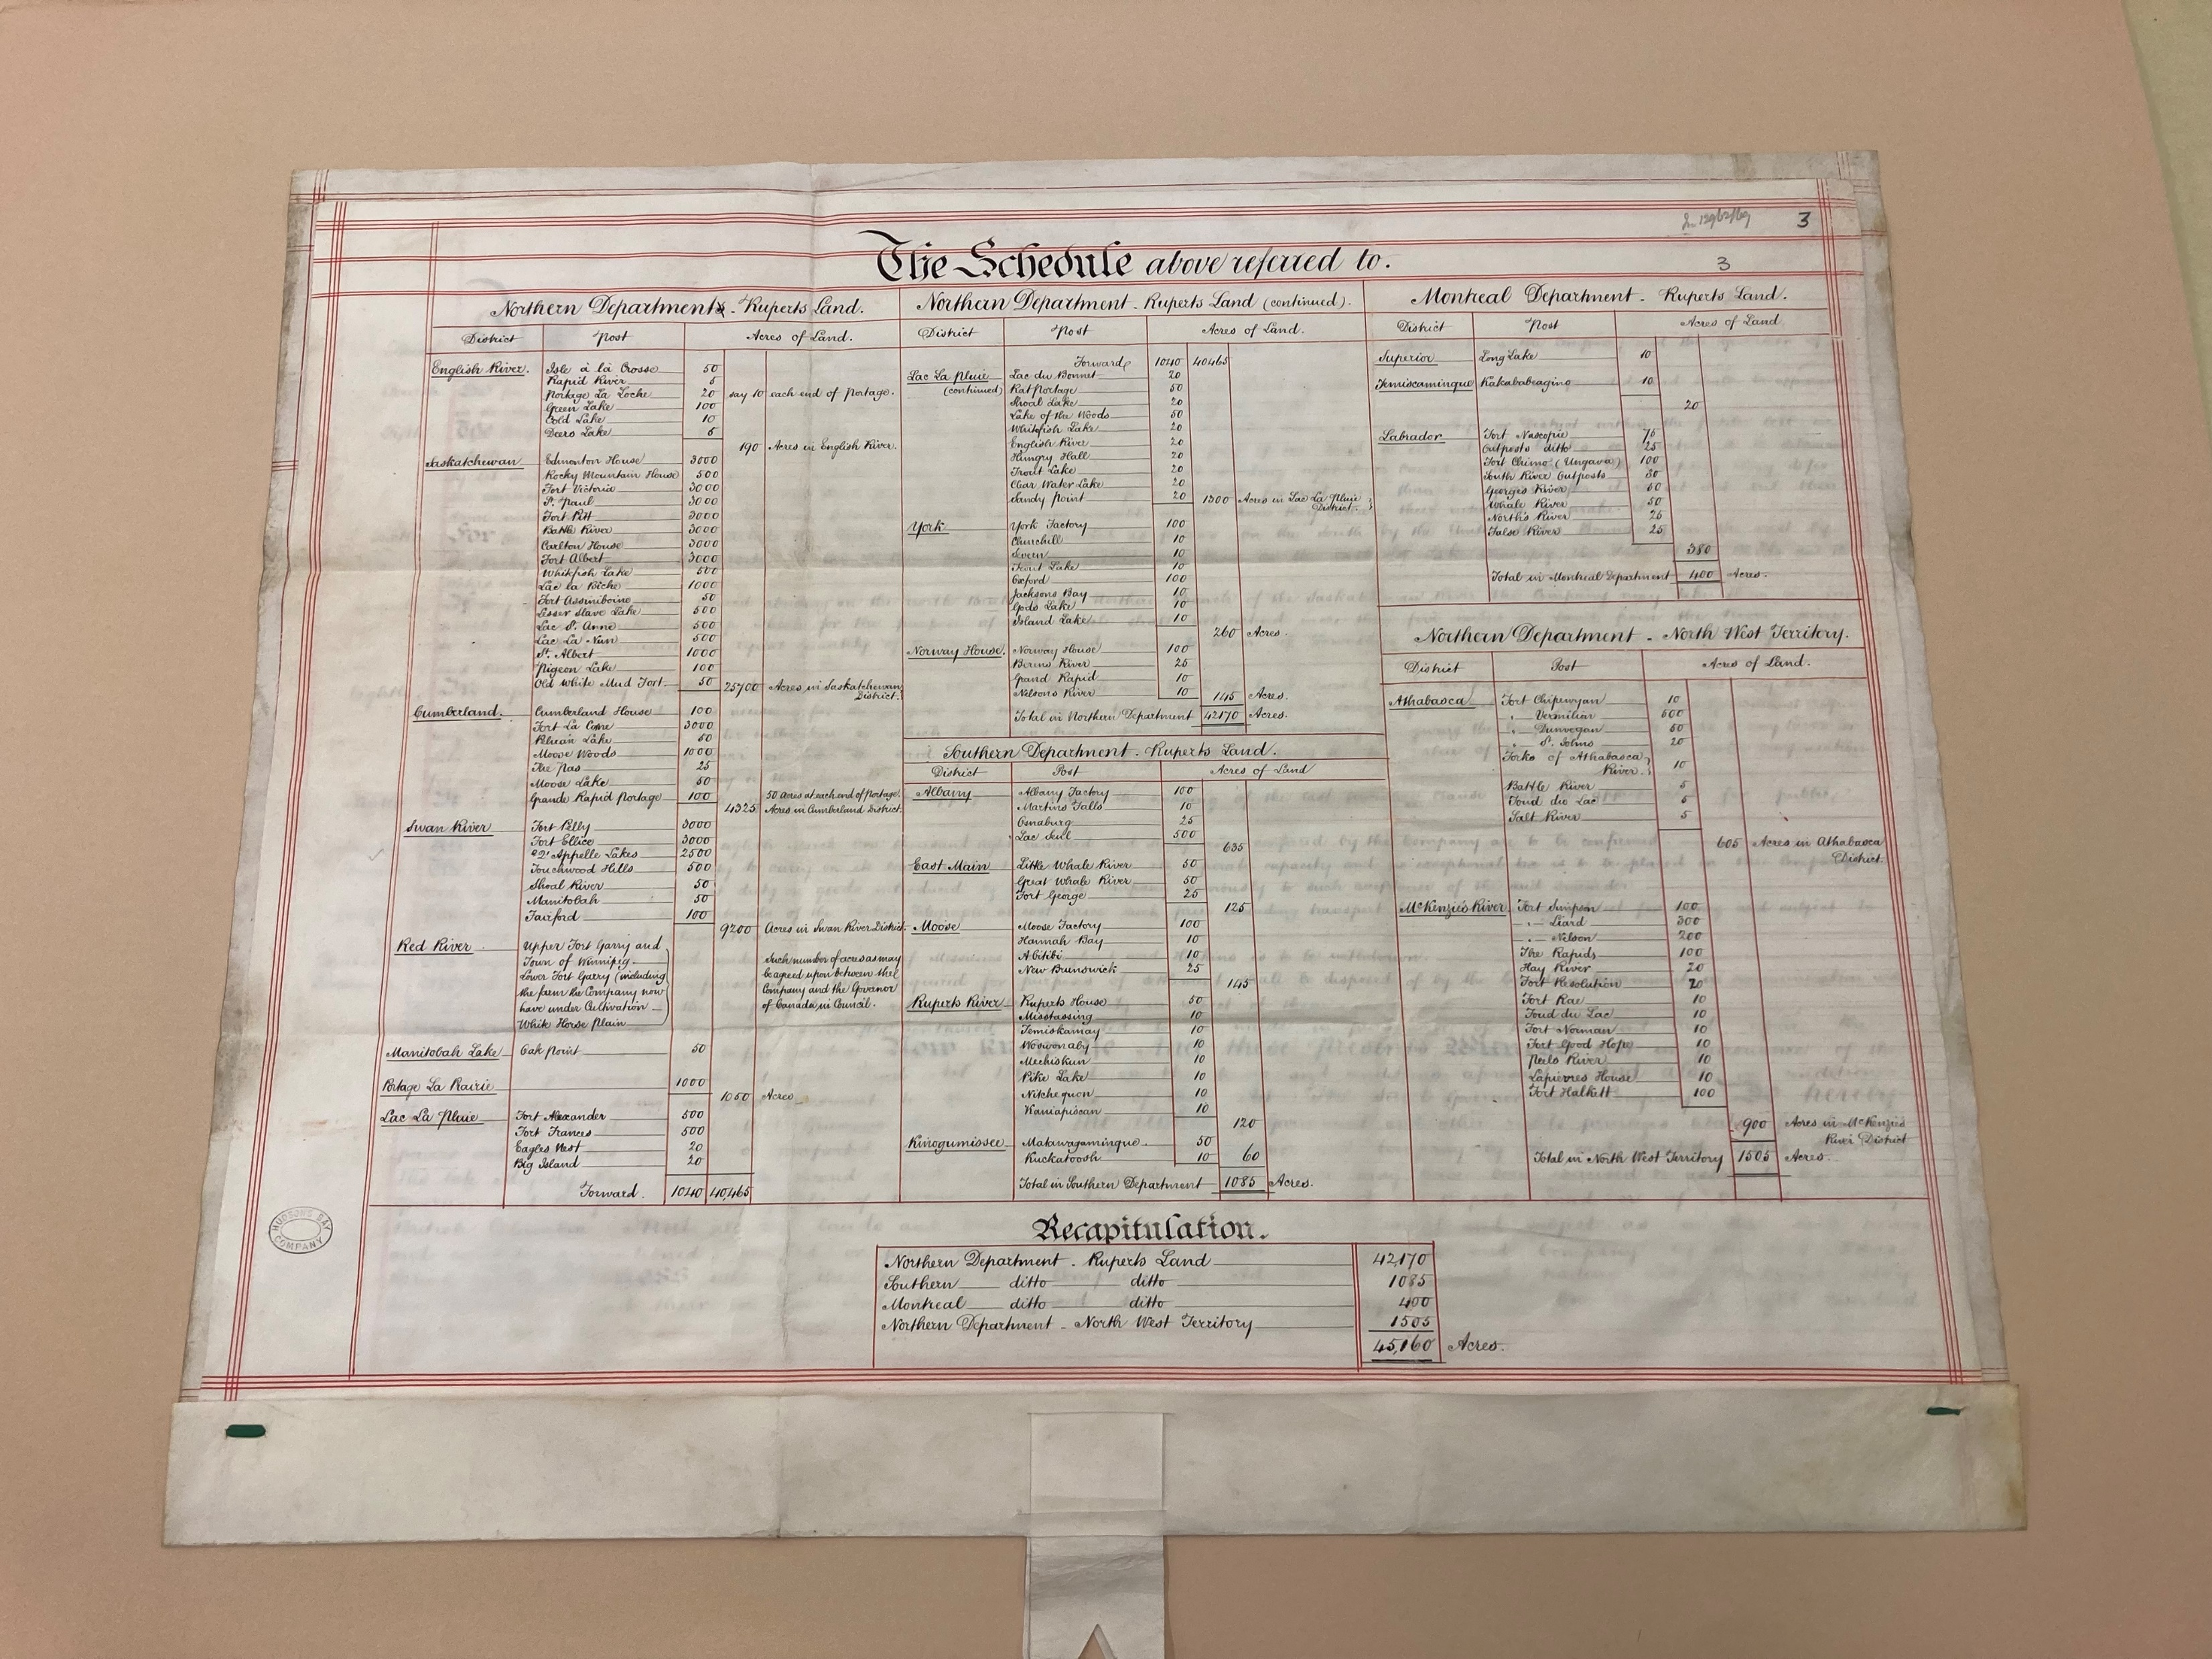
HBCA A.37/19 (H4-MB1-OS1-10) HBC to H.M. Queen Victoria: Deed of Surrender, [1869].

Slide 3
HBC Land Administration after 1870
Land Department was created in 1874
Land in BC was administered by the Western Department until 1891
The Land Department fell under the administration of the Commissioner’s Office (HBC’s headquarters in Canada) from 1892 to 1910
The Land Department reported directly to the Governor and Committee from 1910 until 1961

Slide 4
Finalization of the Deed of Surrender, 1924
There was a clause in the Deed of Surrender that gave HBC and the Dominion Government 50 years to finalize the disposition of lands (December 23, 1920)
HBC entered negotiations with the Canadian government in 1924
At the centre of the 1924 negotiations were the surrender of all lands that HBC held title to “situated within Forest Reserves, Dominion Parks and Indian Reserves in the Fertile Belt.”
HBC was to be compensated for all the land that they surrendered in these areas with other land
Actual land selection and the legal process of obtaining land patents went on until 1930

Slide 5
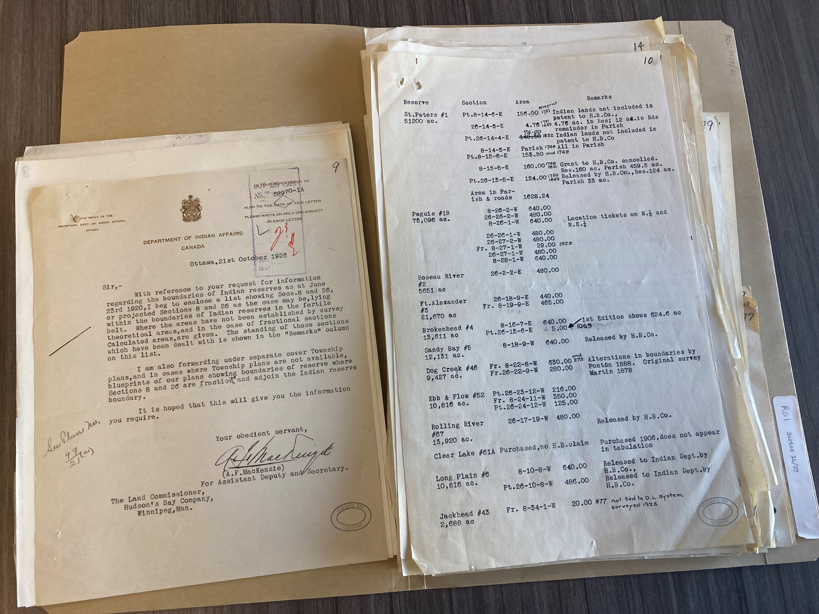
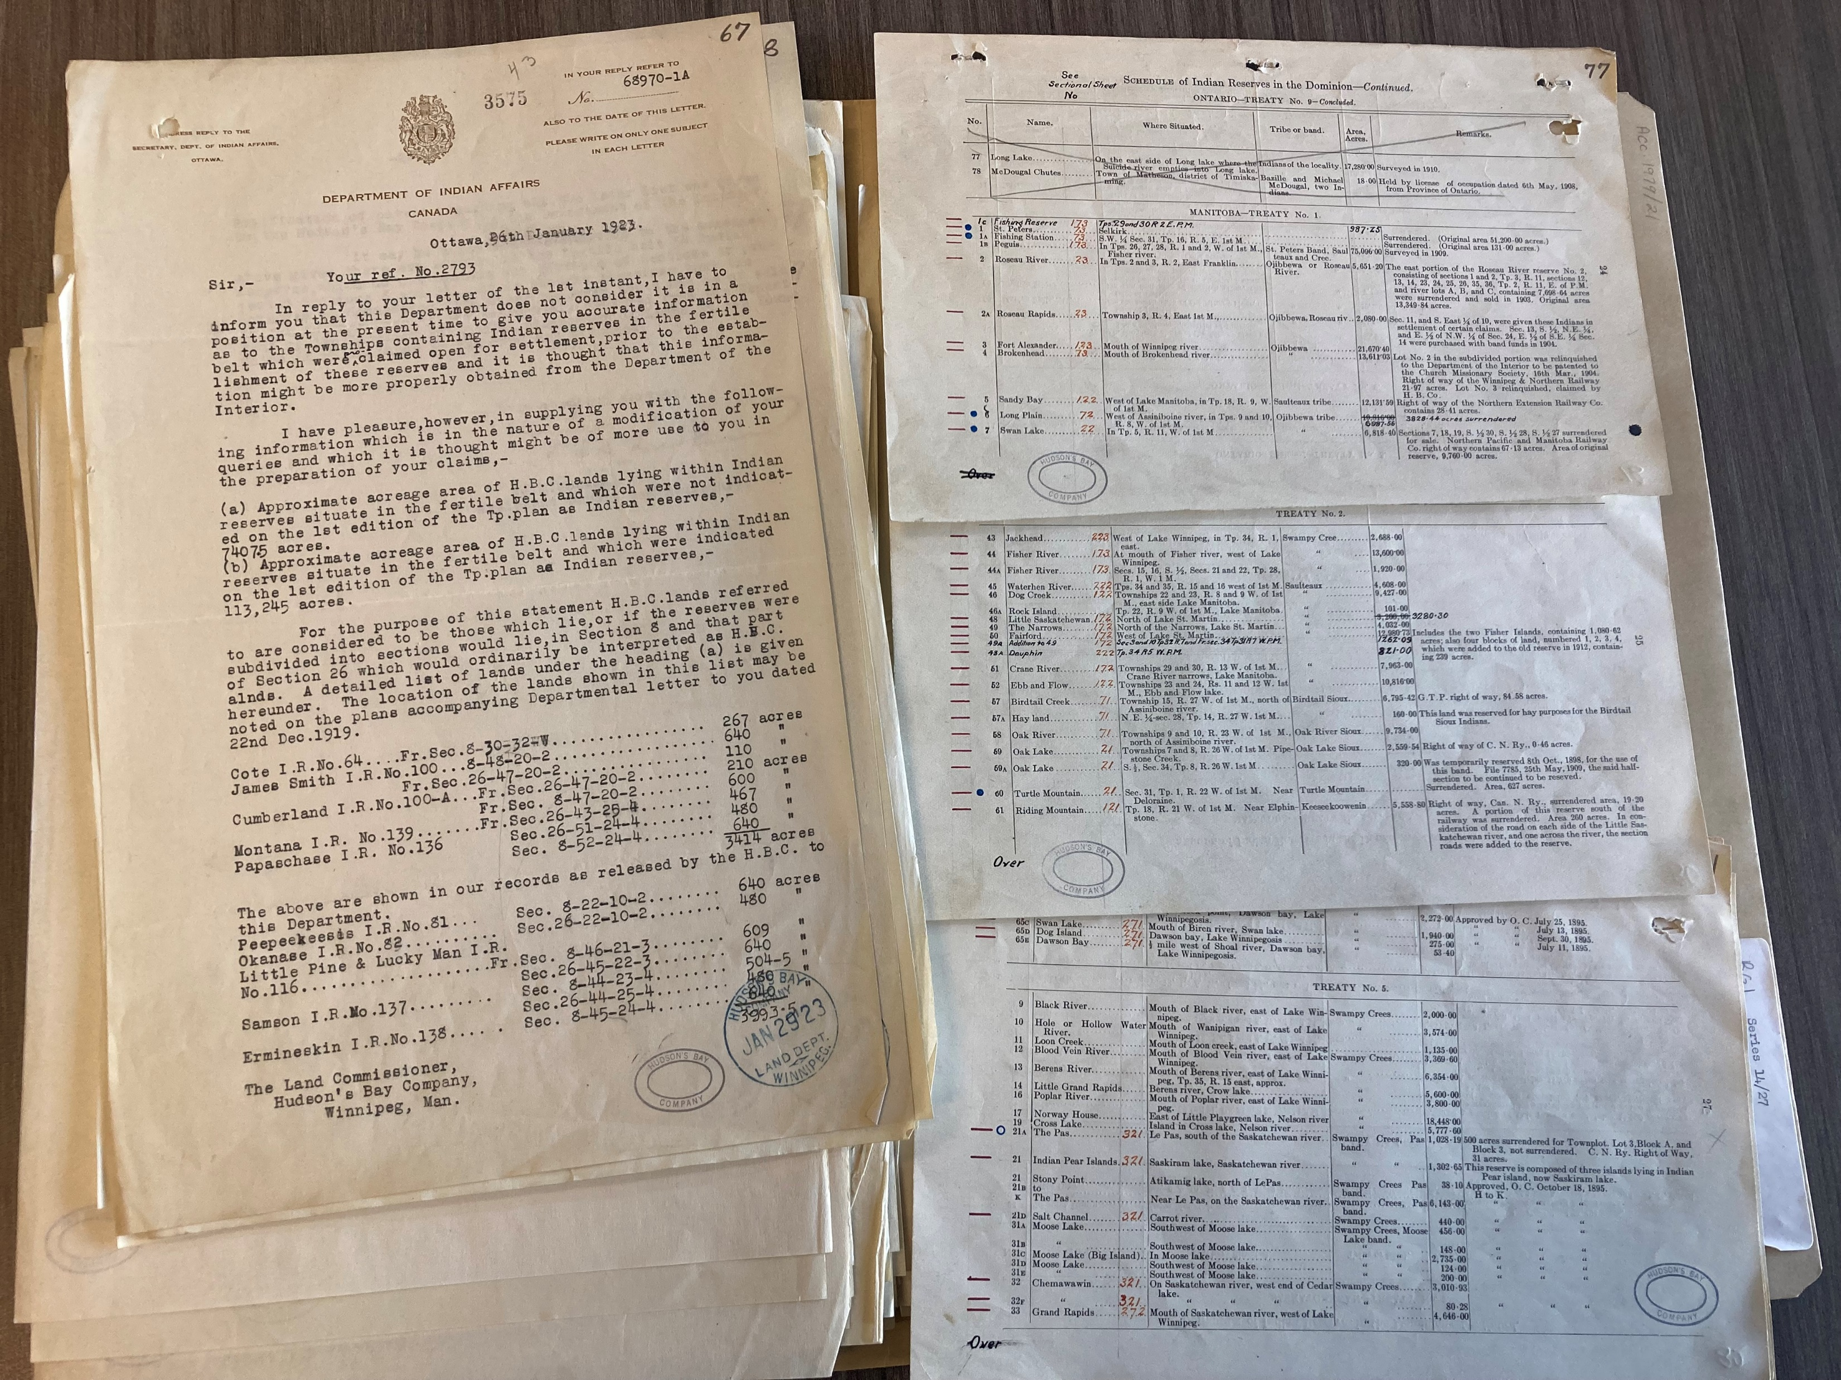
Records are from file HBCA RG1/14/27 Indian Reserves, 1919-1926 in the records series Hudson’s Bay Company land account correspondence (Land Department)

Slide 6
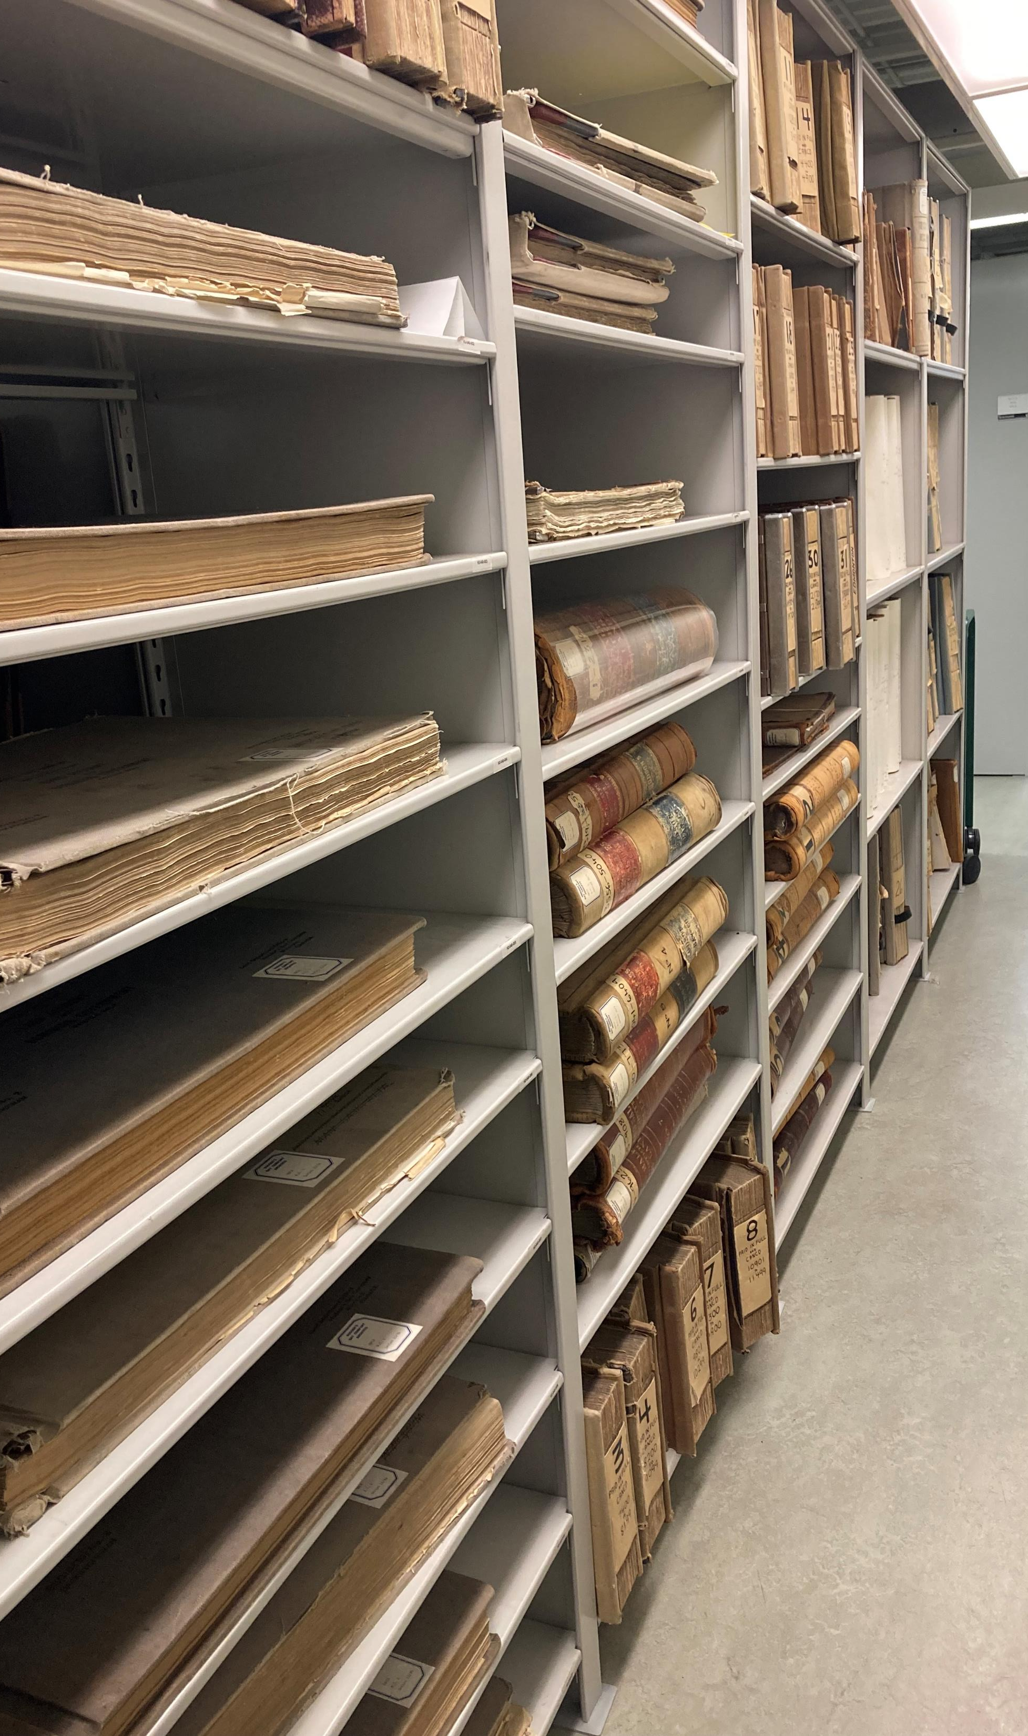
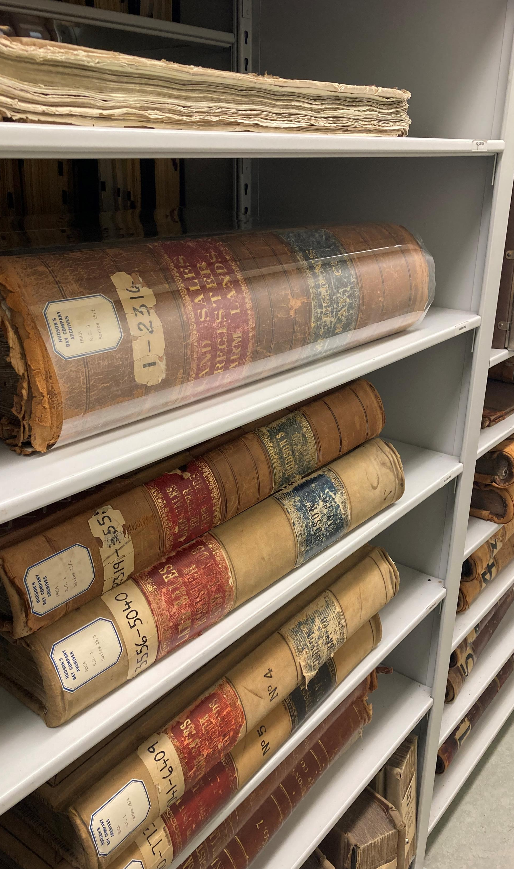

Slide 7
Rupert’s Land Trading Company (RLTC), 1938-1972
In 1945, it was decided that RLTC would be used as a tax shelter to hold and acquire HBC staff houses and mortgages
By 1947, HBC was leasing all of its stores, dwellings and other properties from RLTC
In 1955, a Quebec version of this company was established to reduce double taxation in that province
In 1961, HBC transferred the duties and responsibilities of the Land Department to the Rupert’s Land Trading Company
RLTC oversaw the process of obtaining mineral titles in HBC’s name for approx. 5 million acres of land which had previously been sold without having the title transferred

Slide 8
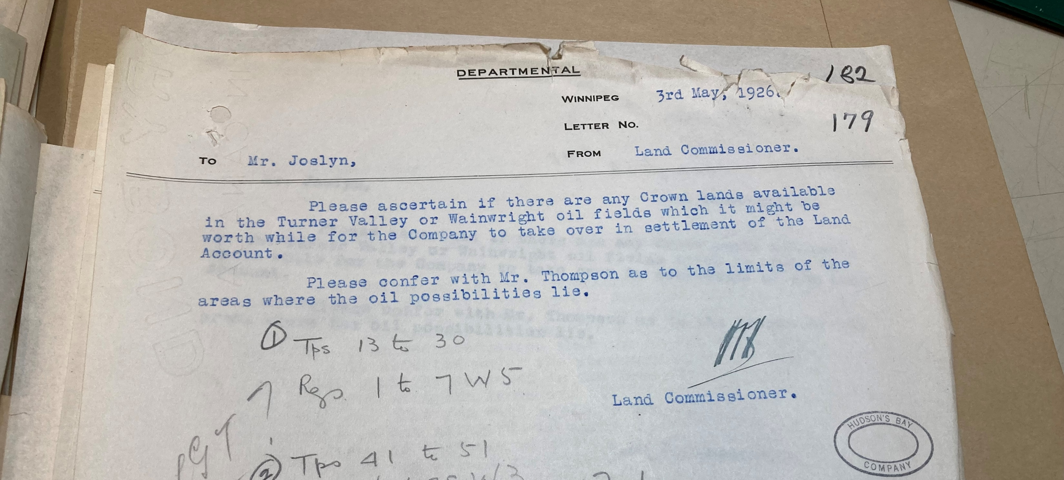
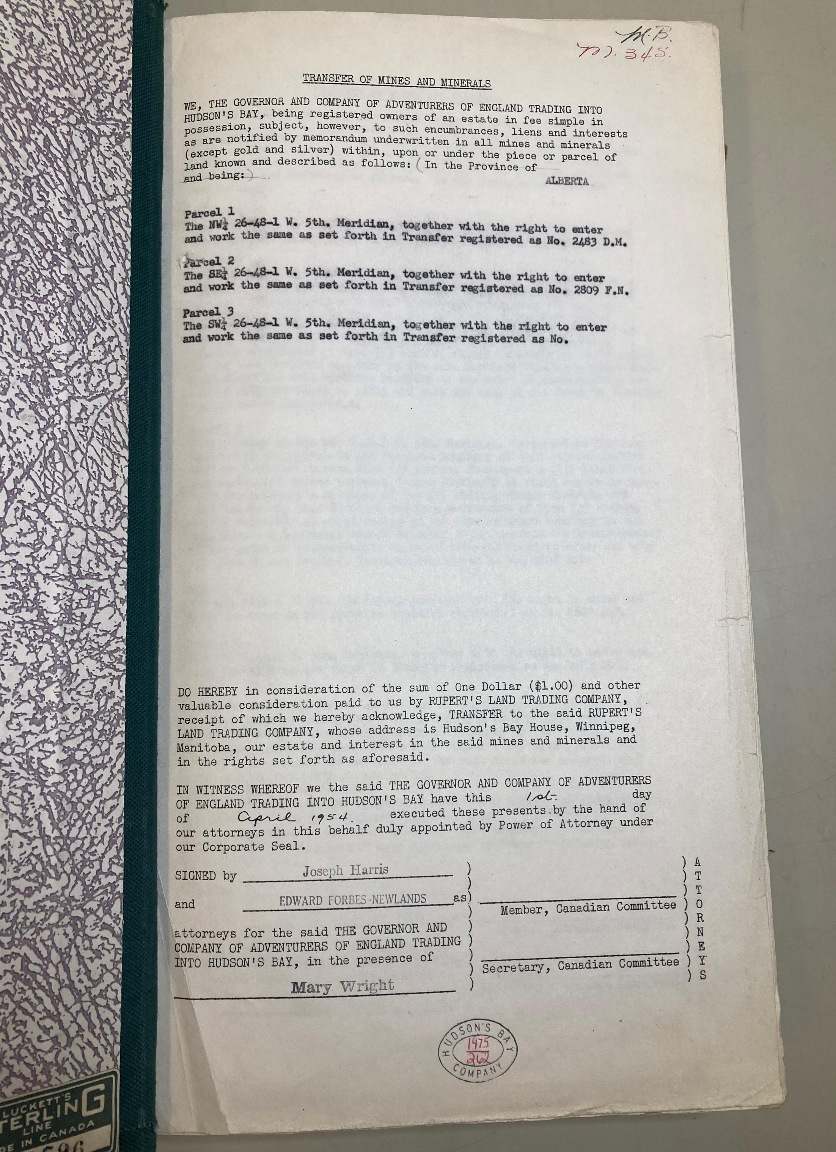
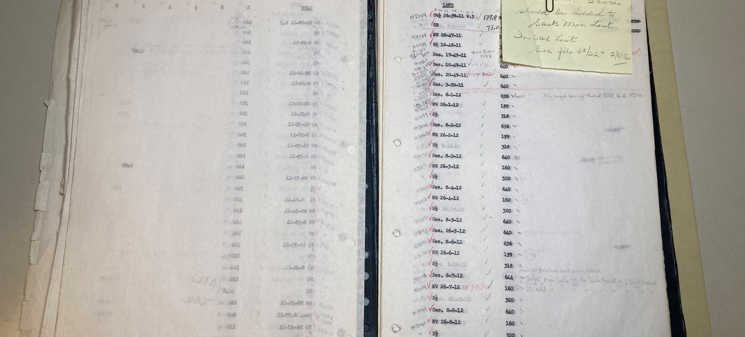

Slide 9
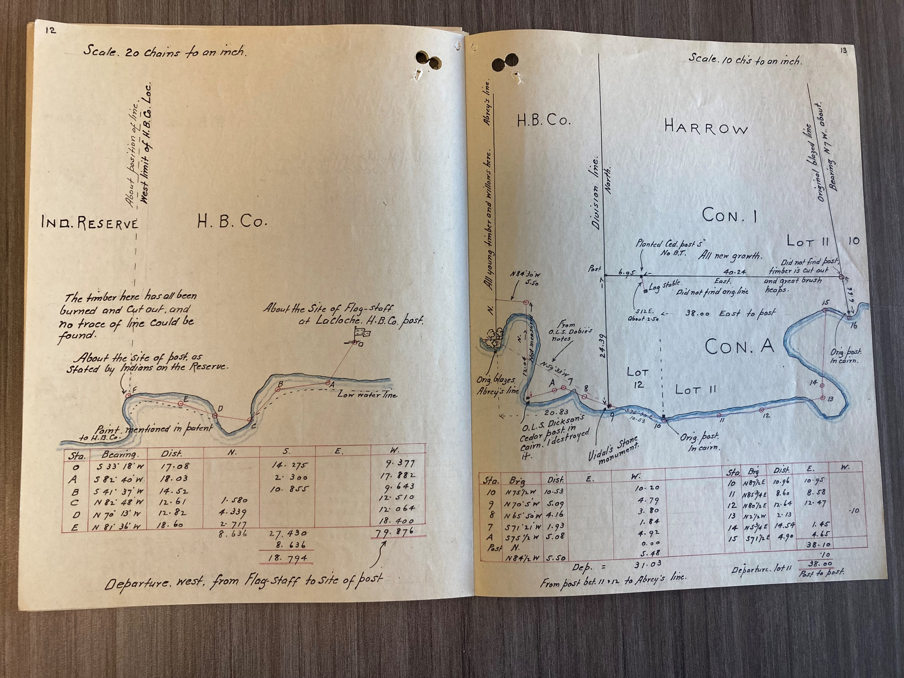
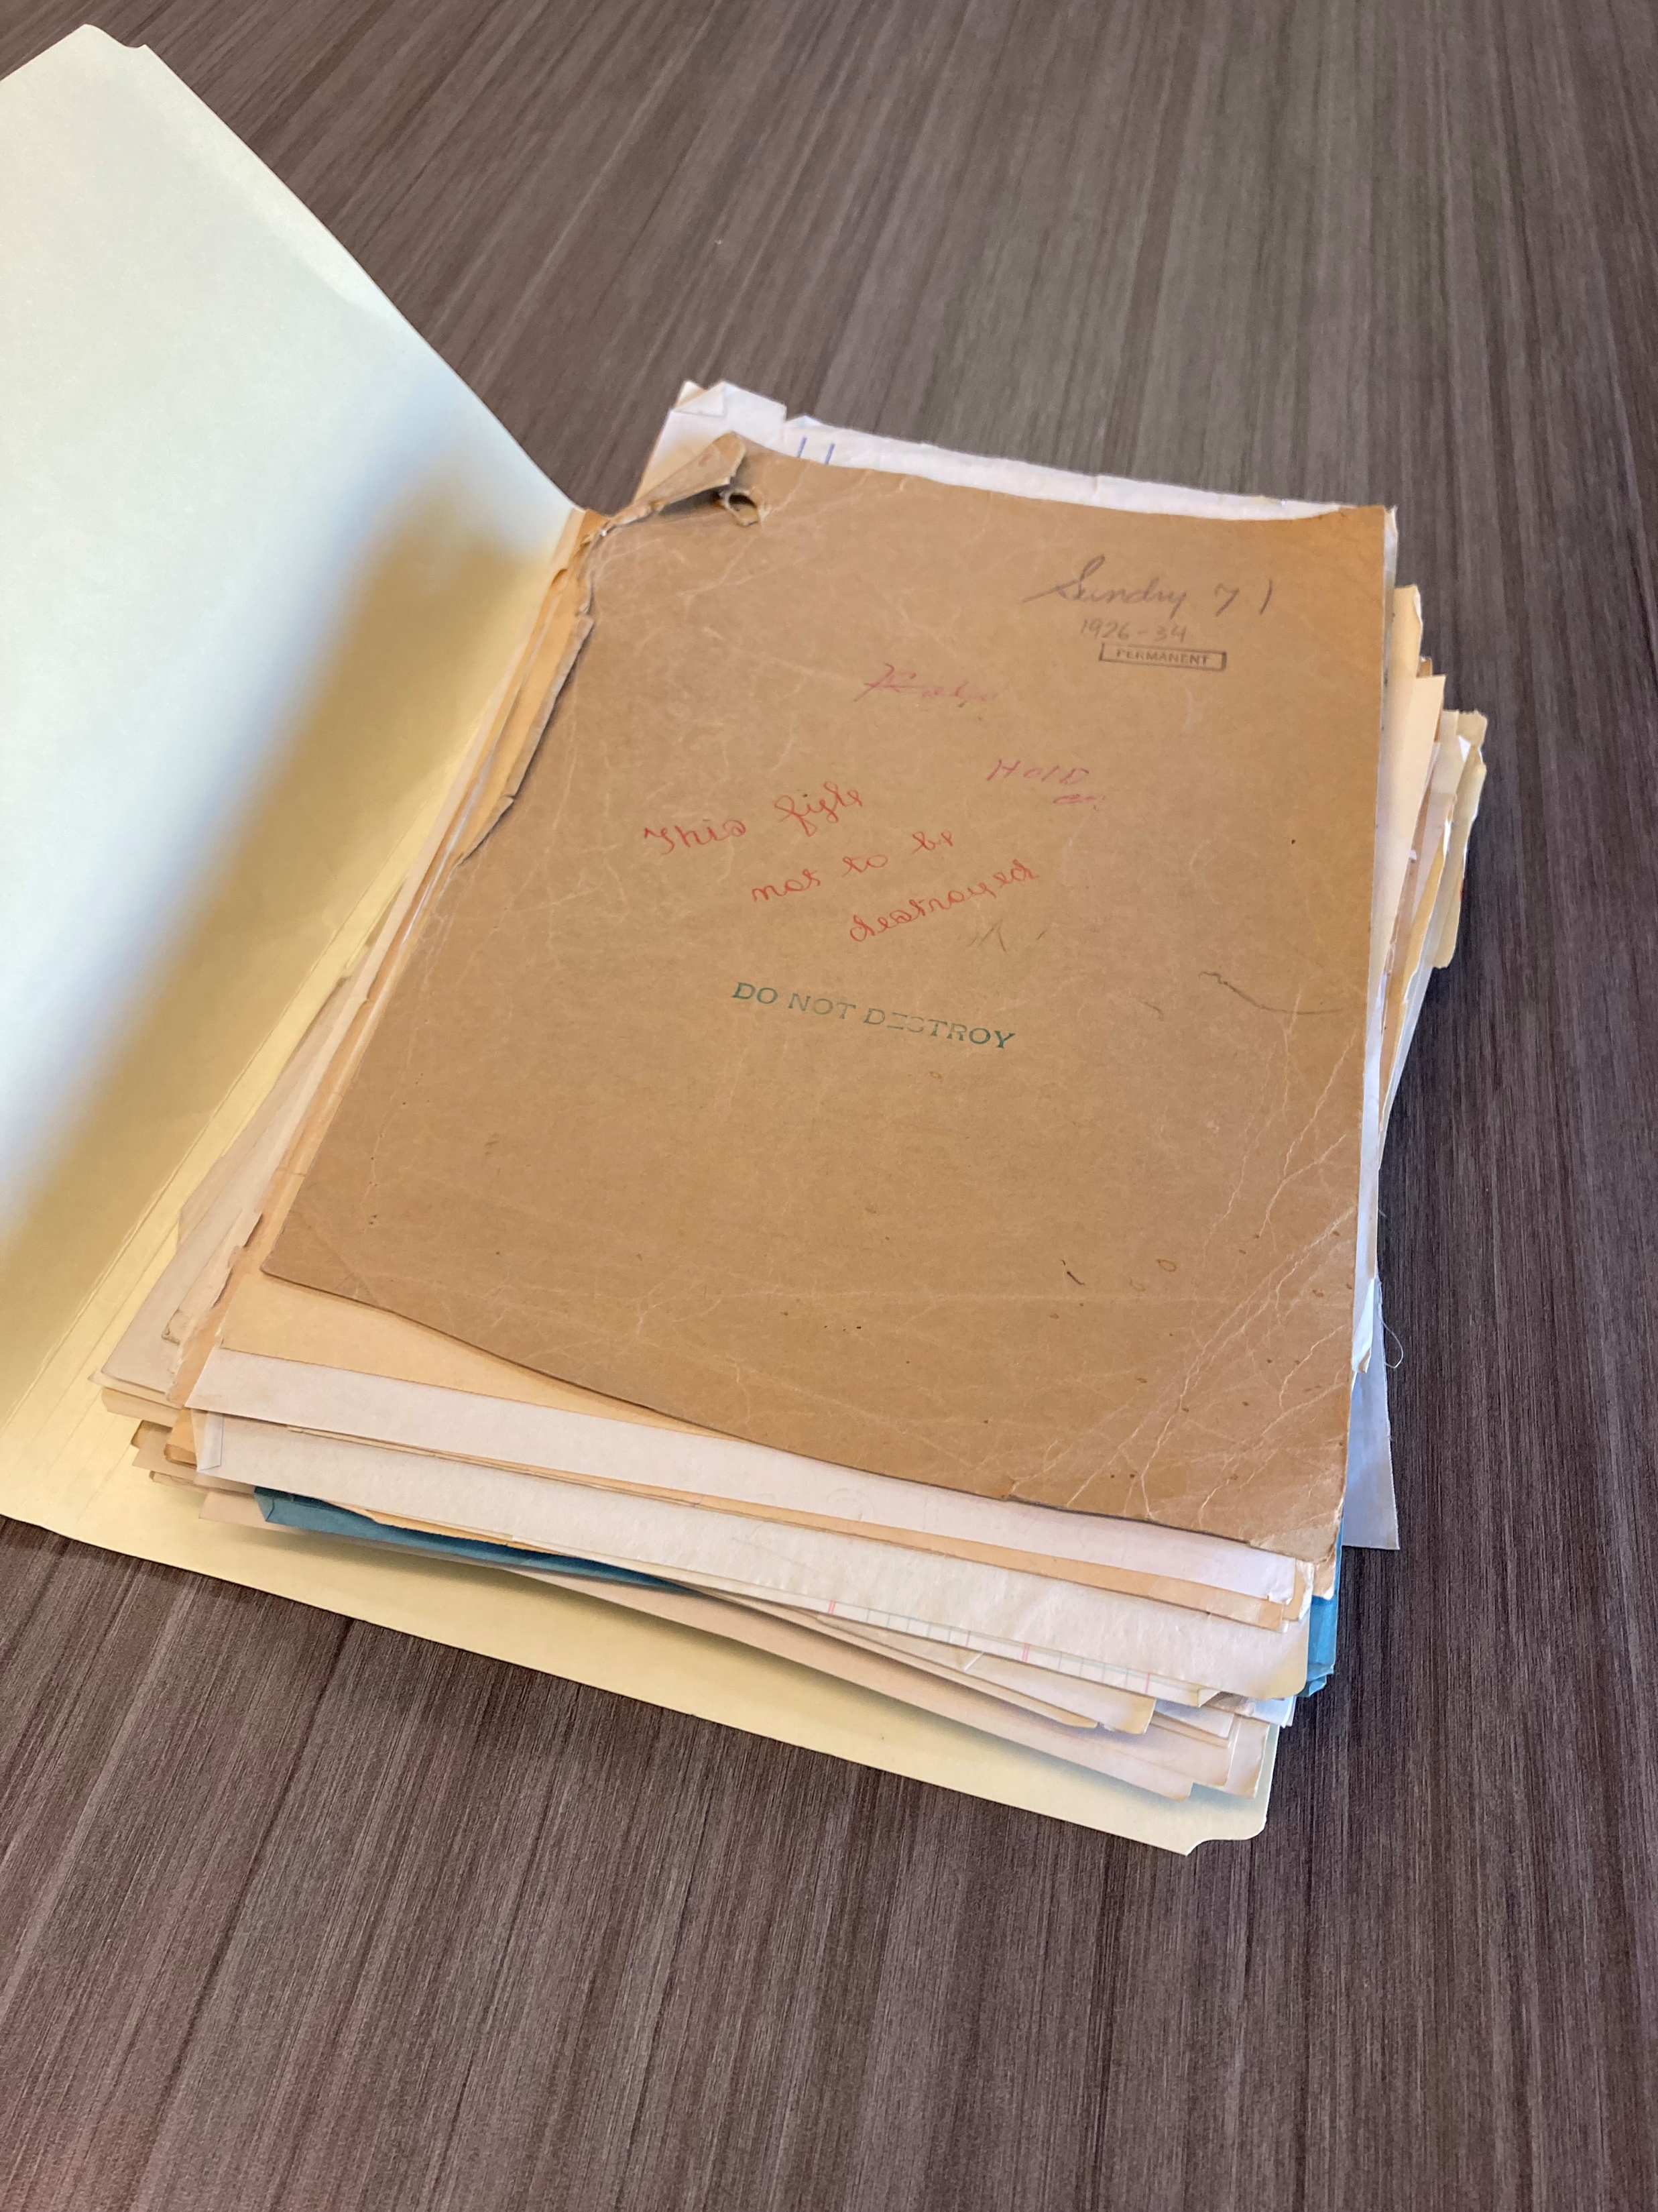
From file “Sundry Sale 71 – La Cloche”, 1926-1934. Land Department Sundry Sale files series

Slide 10
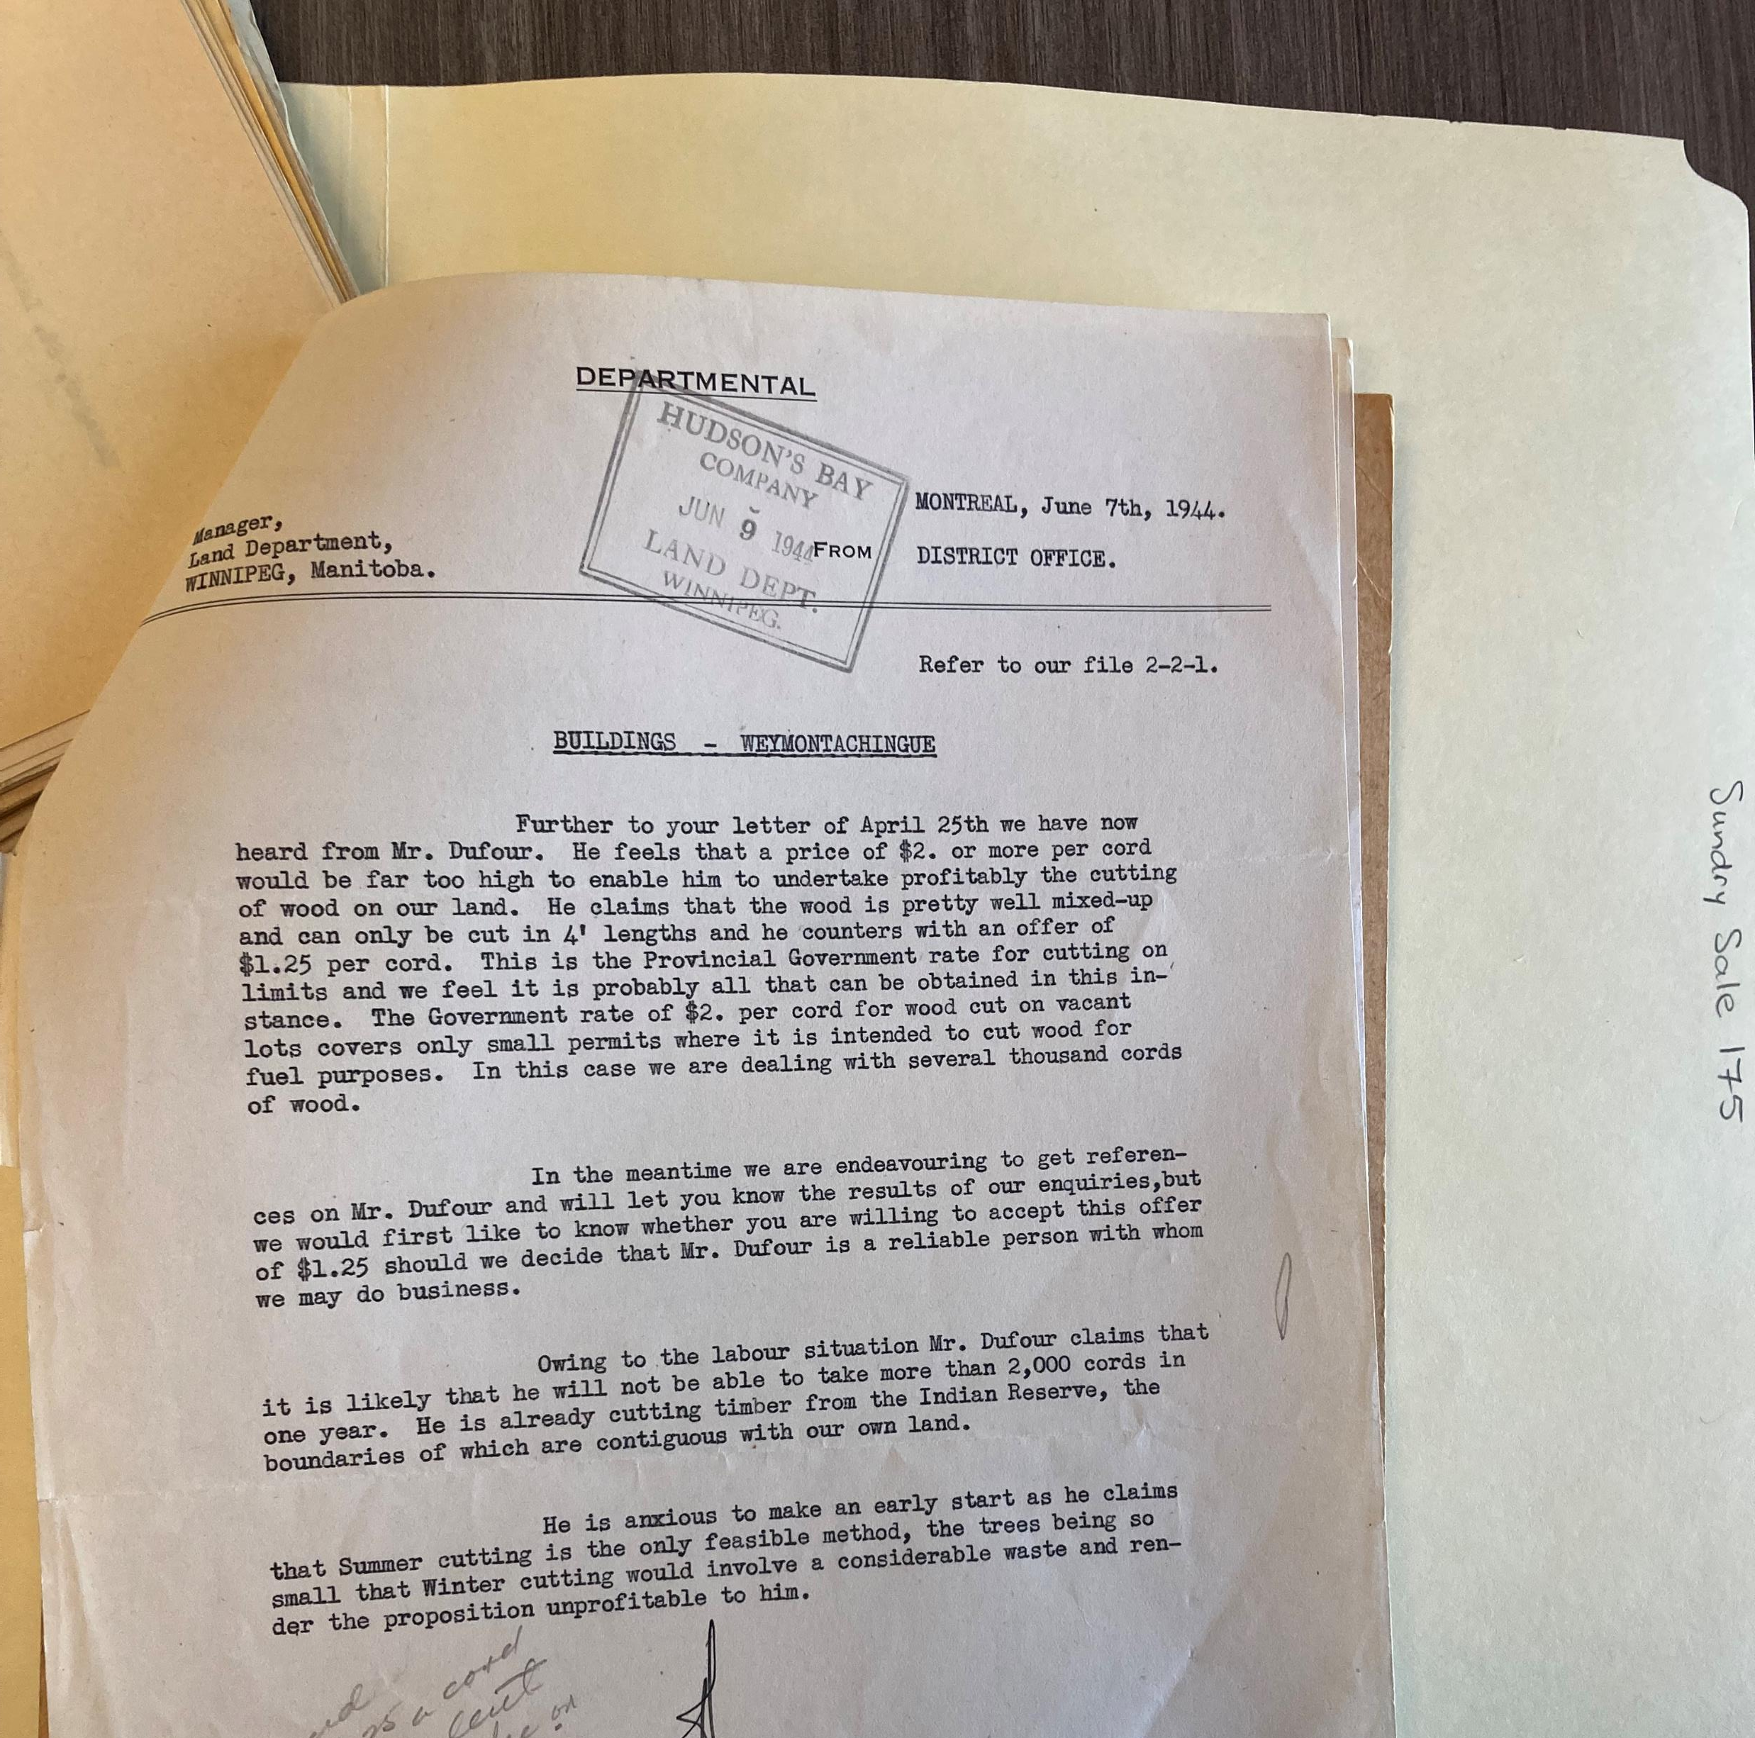
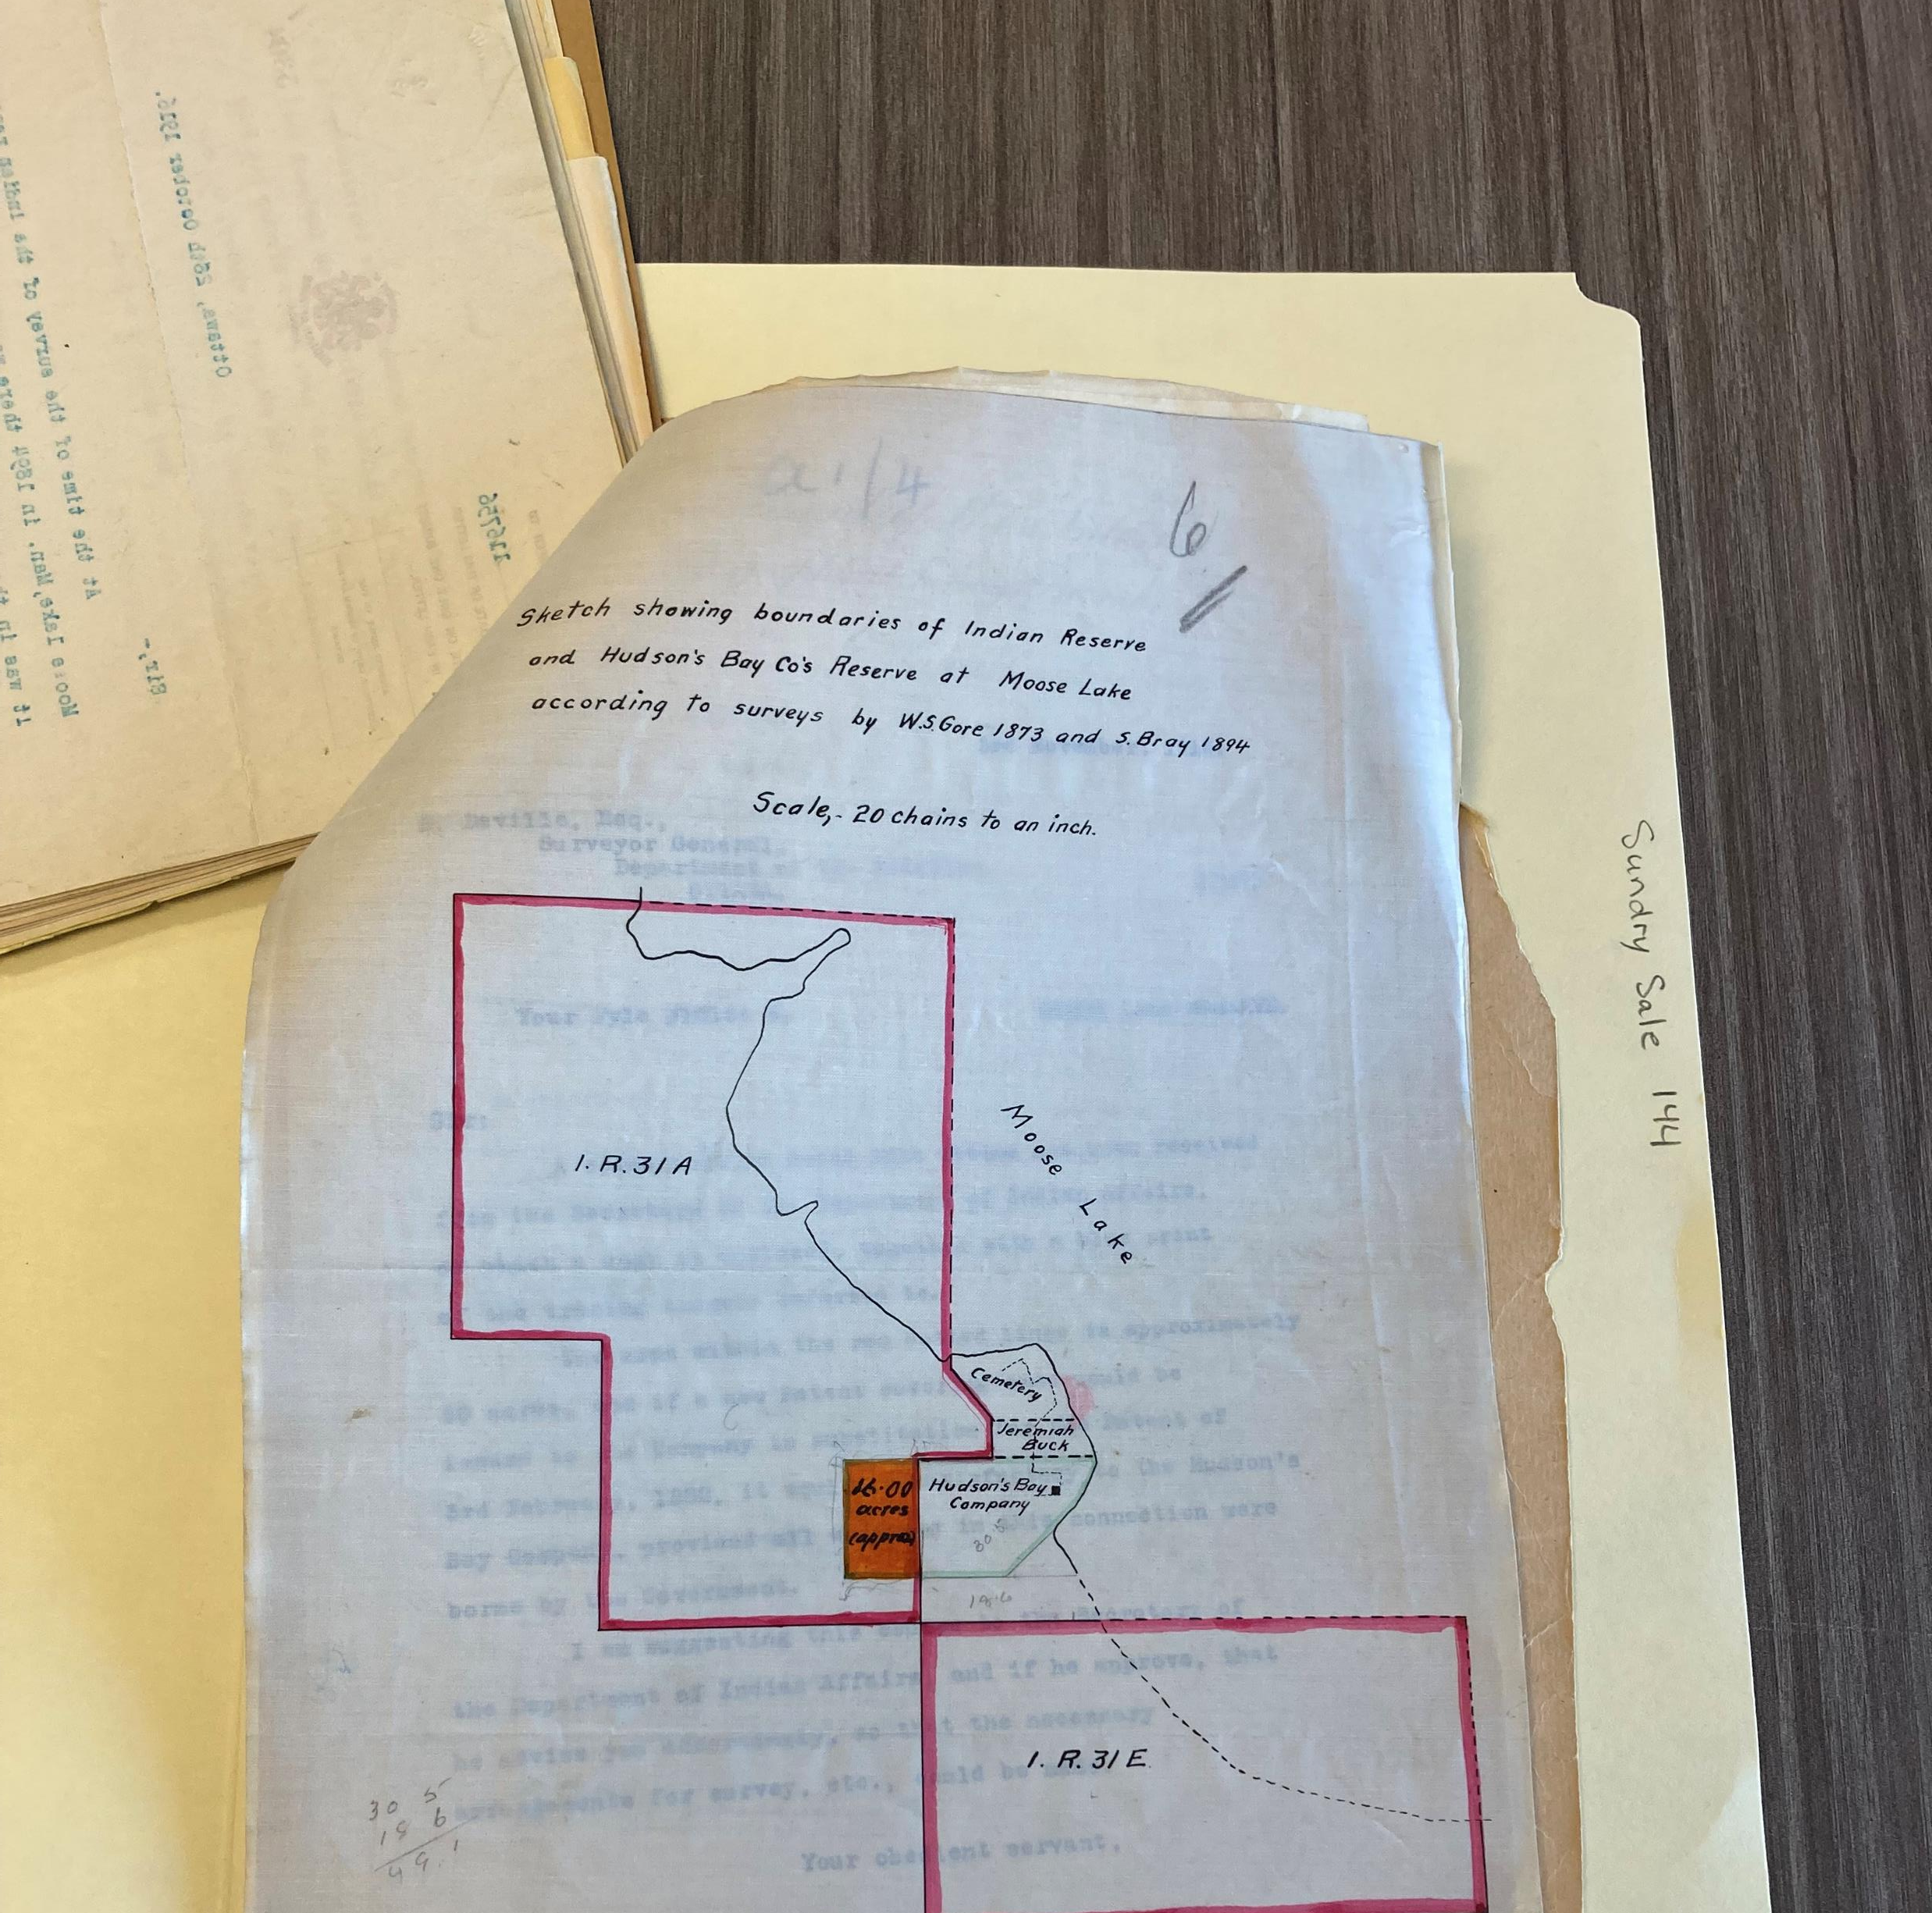
Left: “Sundry Sale 175 (Timber Sale) – Weymontachingue” 1944-1950
Right: “Sundry Sale 144 – Moose Lake” 1916-1948

Slide 11
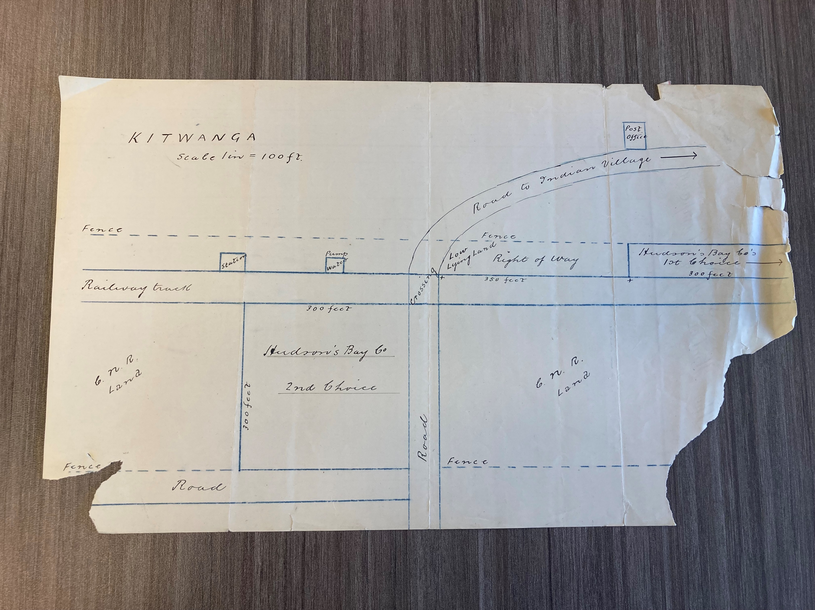
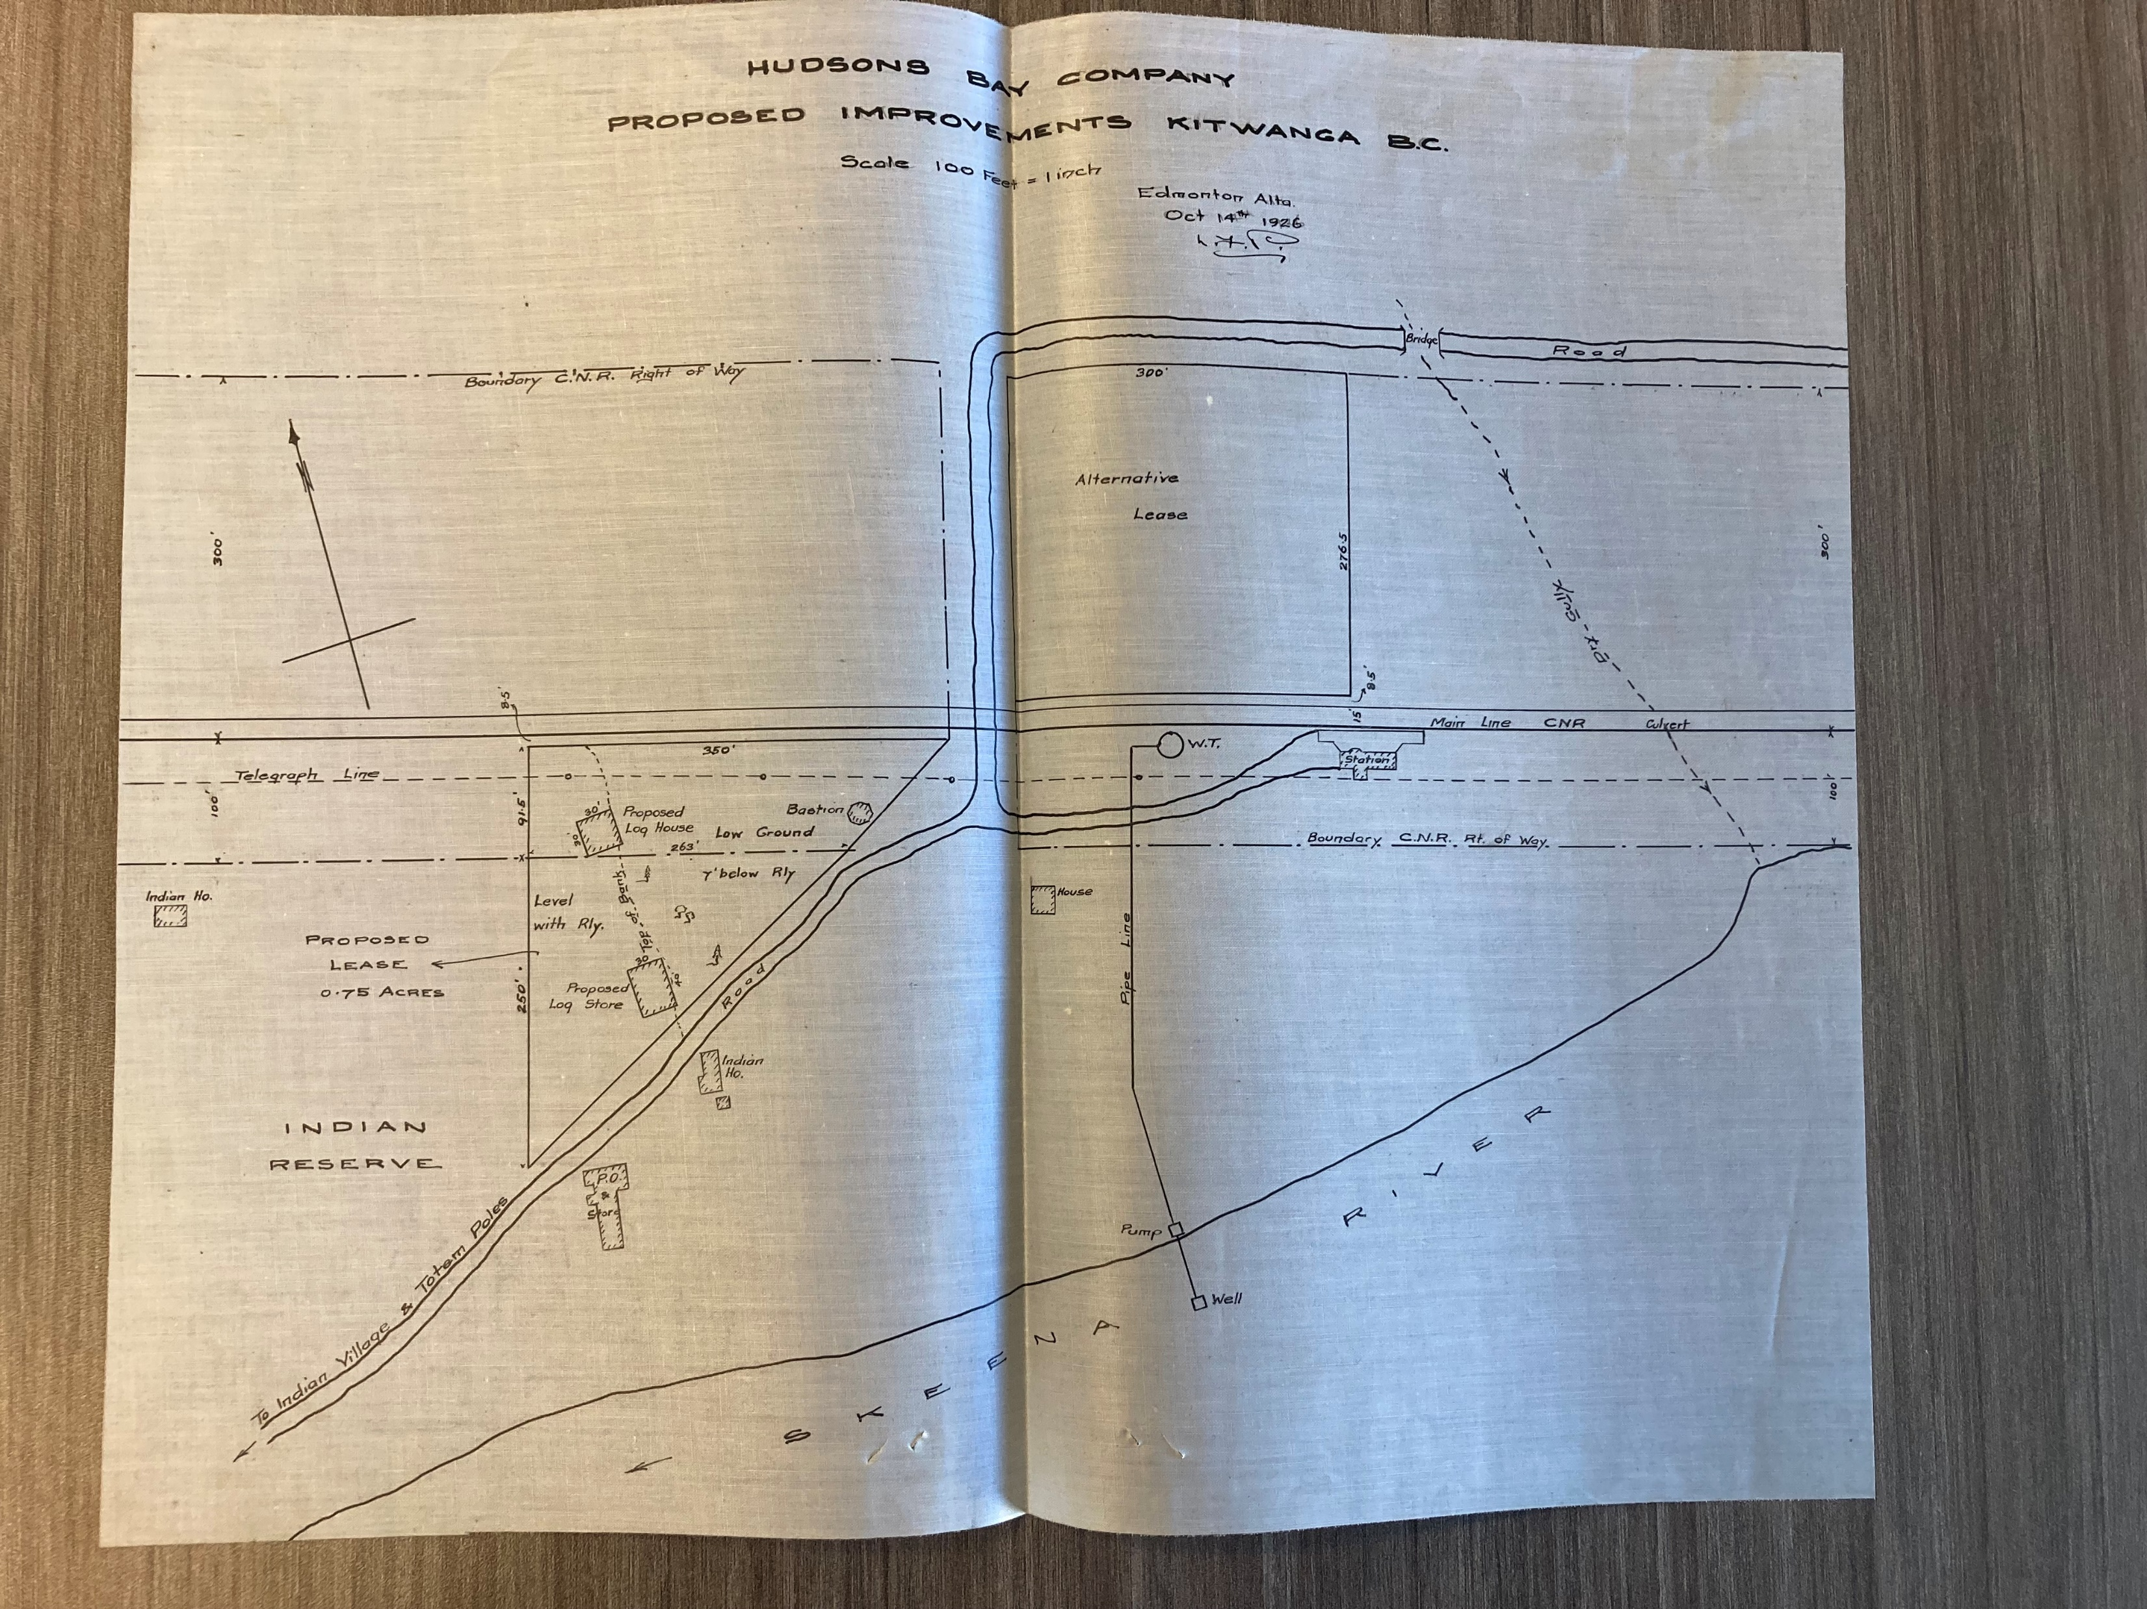
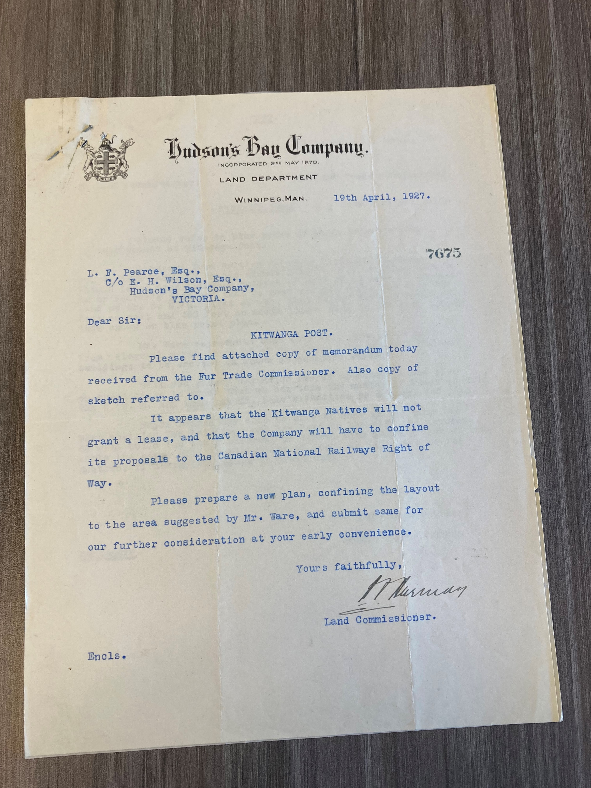
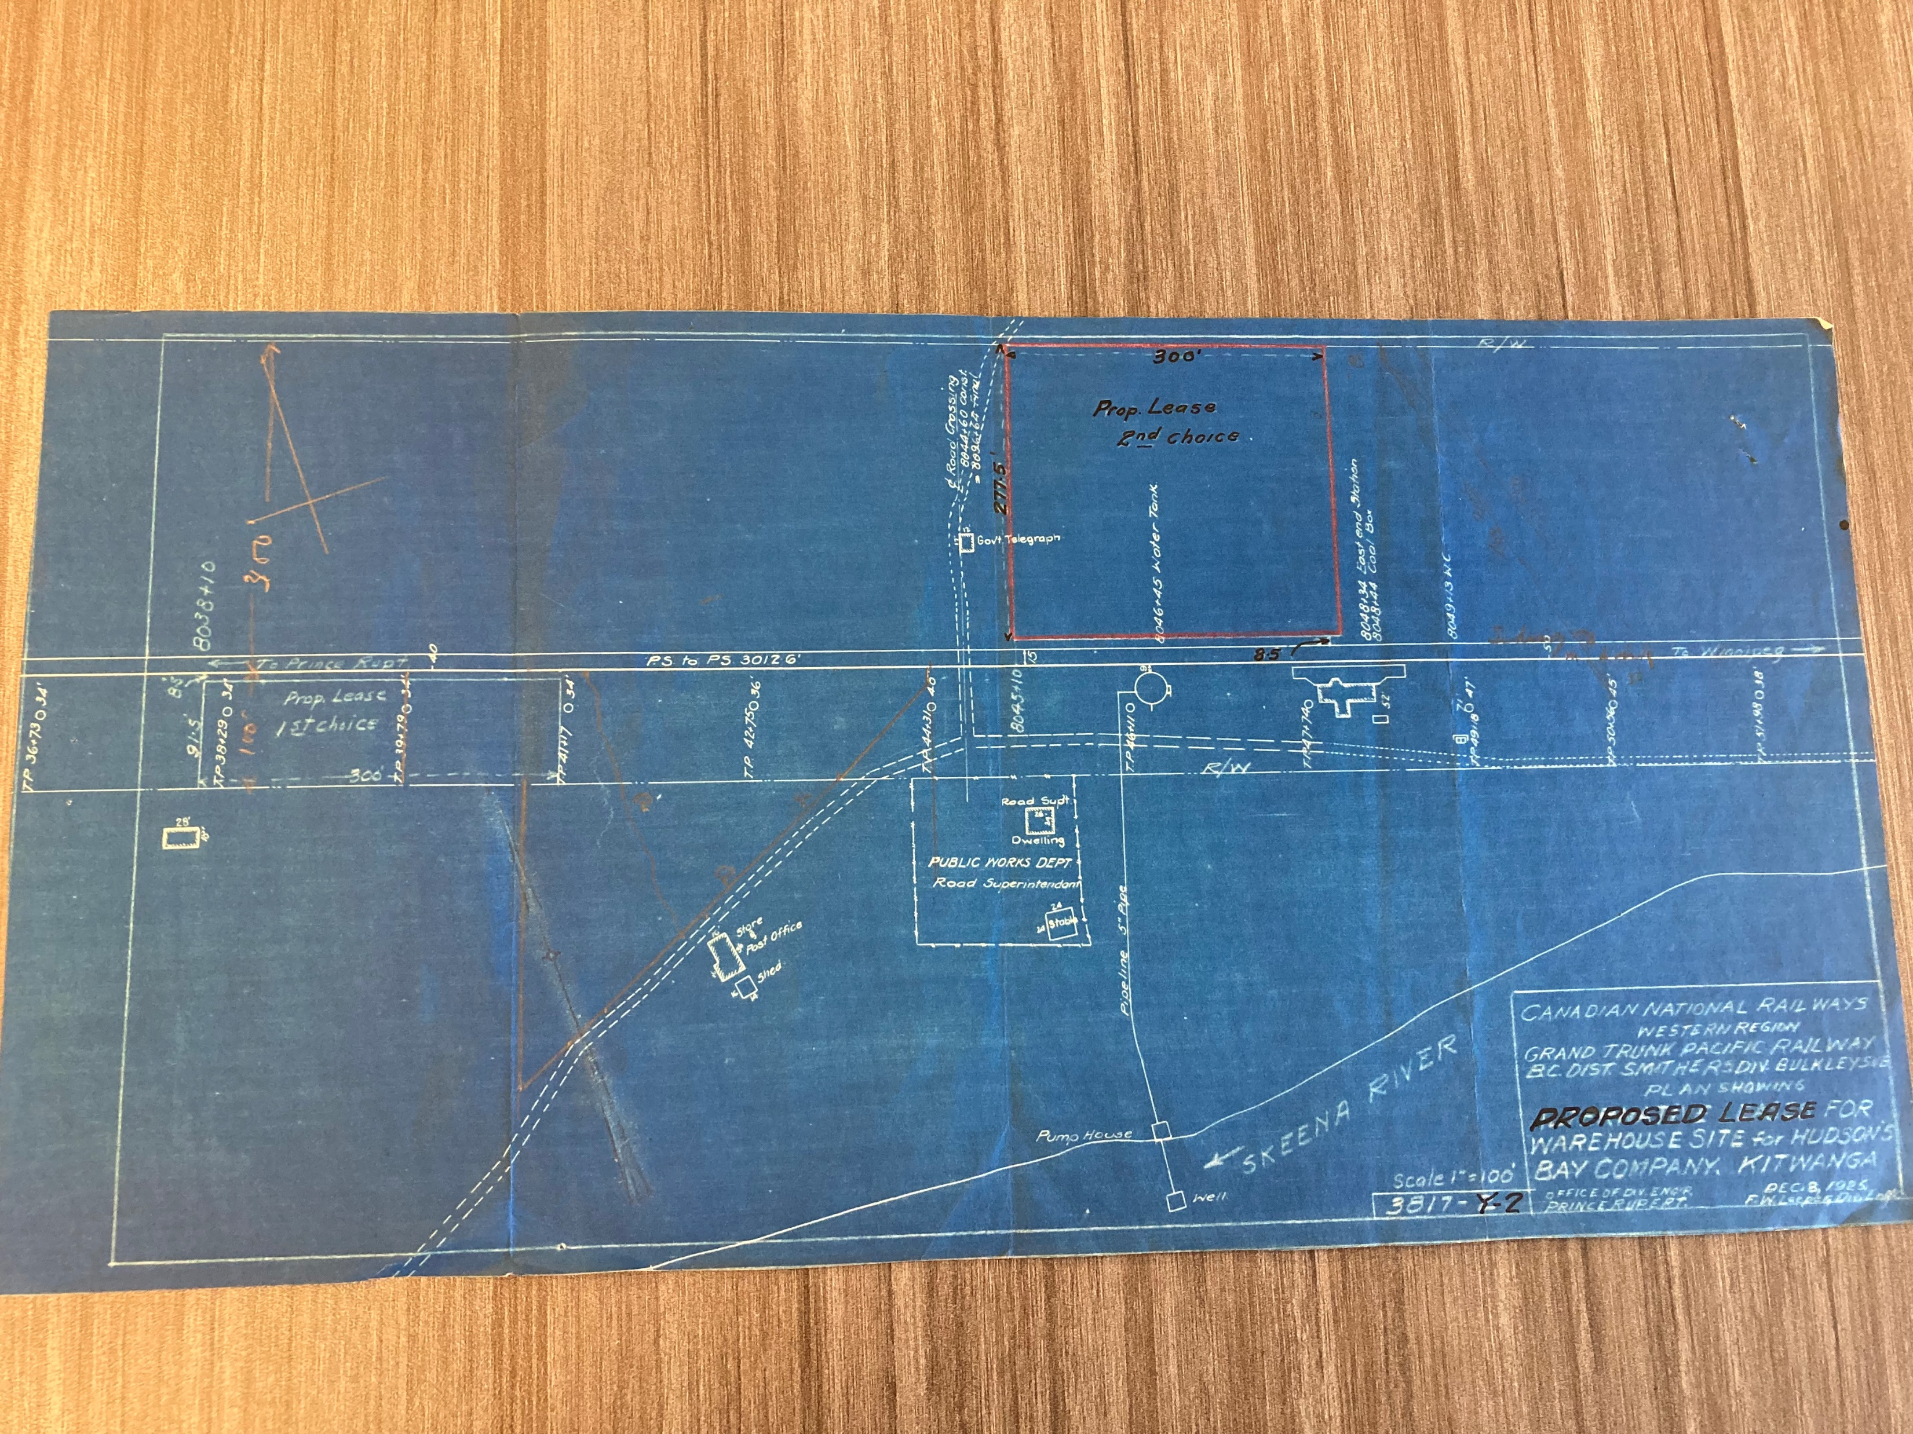
Records from file “L.F. Pearce – Kitwanga” 1926-1929, L.F. Pearce’s Land Department Files

Slide 12
Contact us: Hudson’s Bay Company Archives Email: hbca@gov.mb.ca Telephone: 204-945-4949 Michelle Rydz, Archivist Email: michelle.rydz@gov.mb.ca

