Slide 1
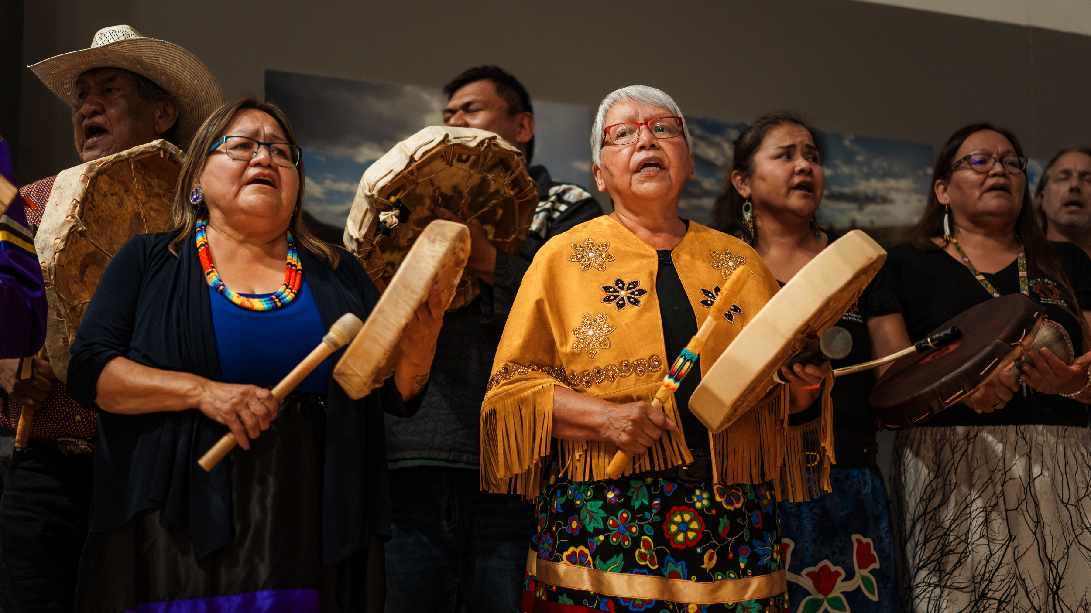

Tsqewt
A wrong is righted. An Esk’etemc victory.

Slide 2
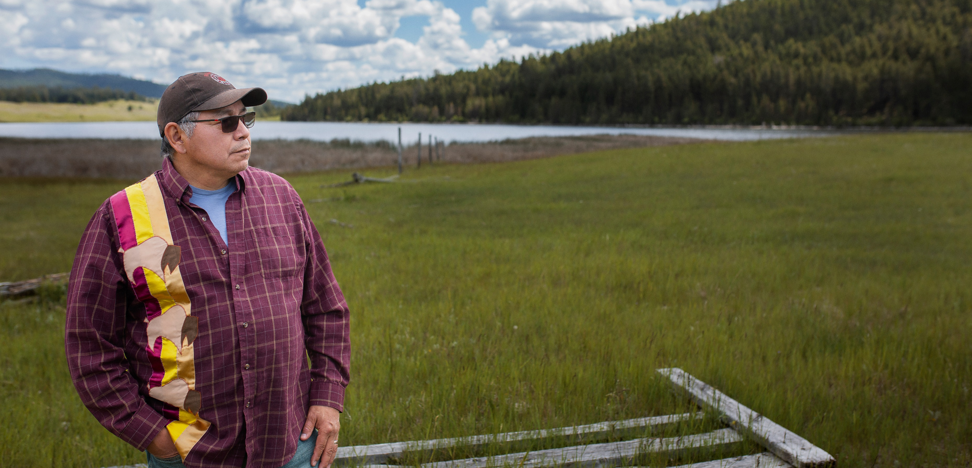
The story of Tsqewt. IR#6
With Fred Robbins, Kukpi7 Esk’etemc

Slide 3
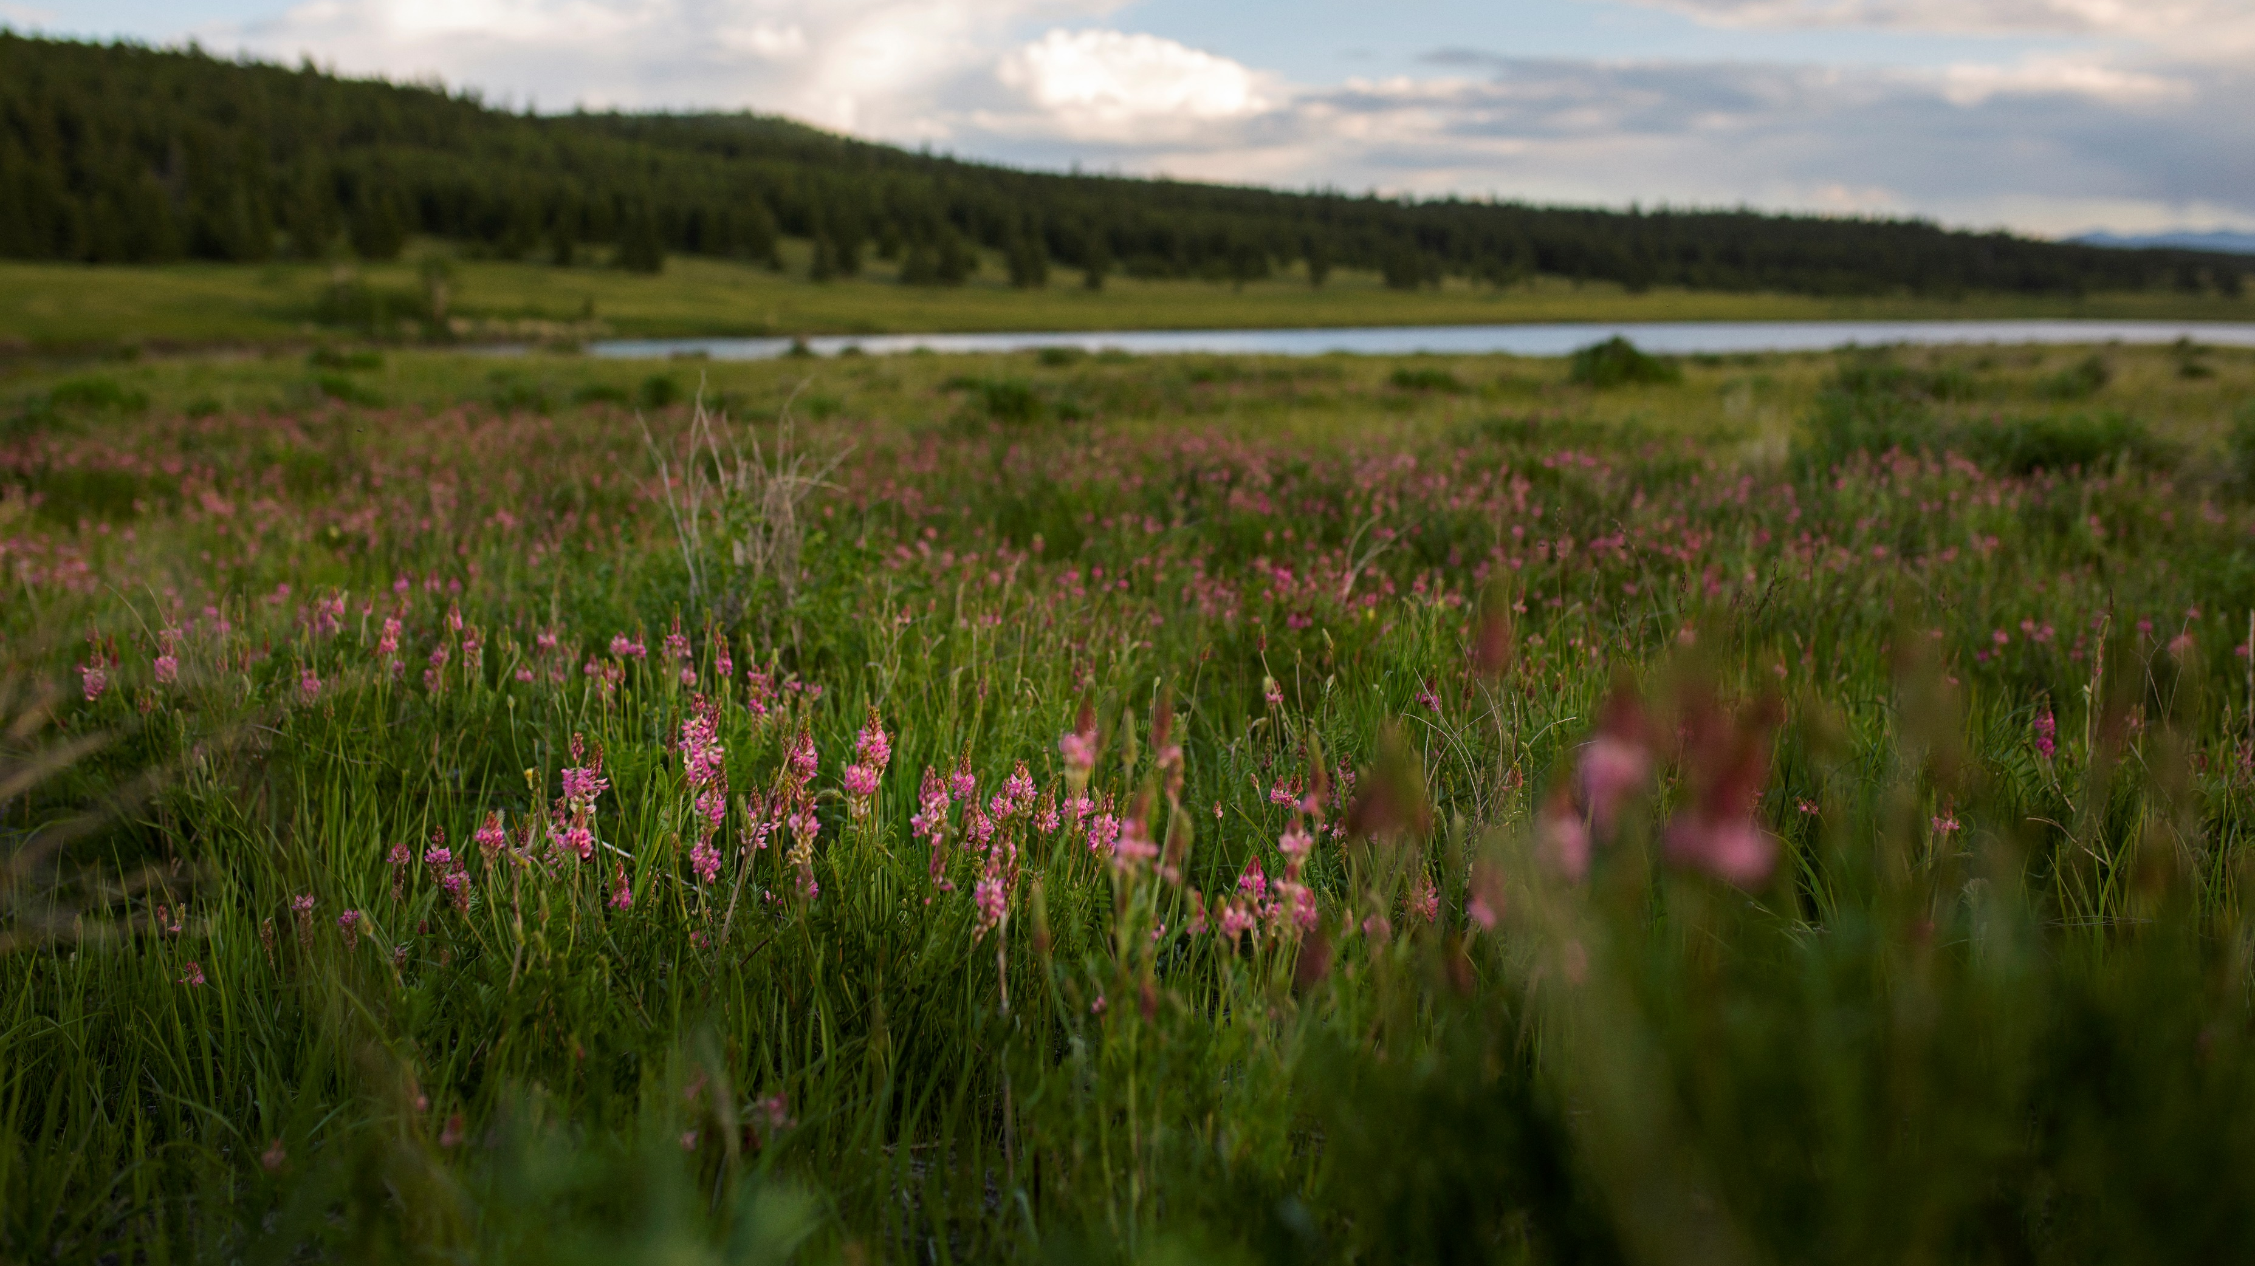
Tsqewt: an Esk’etemc Victory

Slide 4
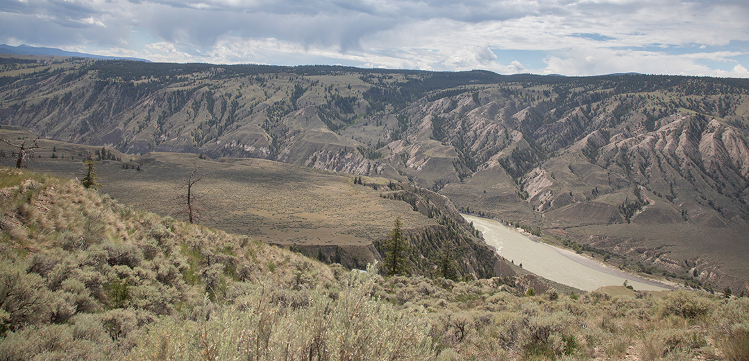
2003
Esk’etemc files the claim with the Specific Claims Branch.

Slide 5
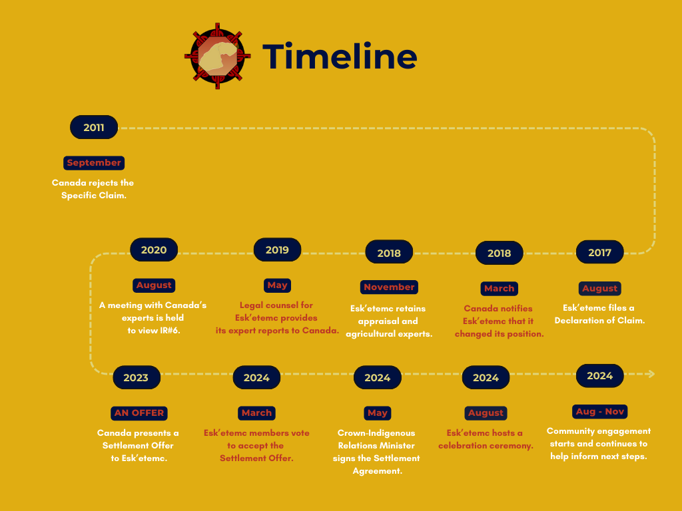

Slide 6
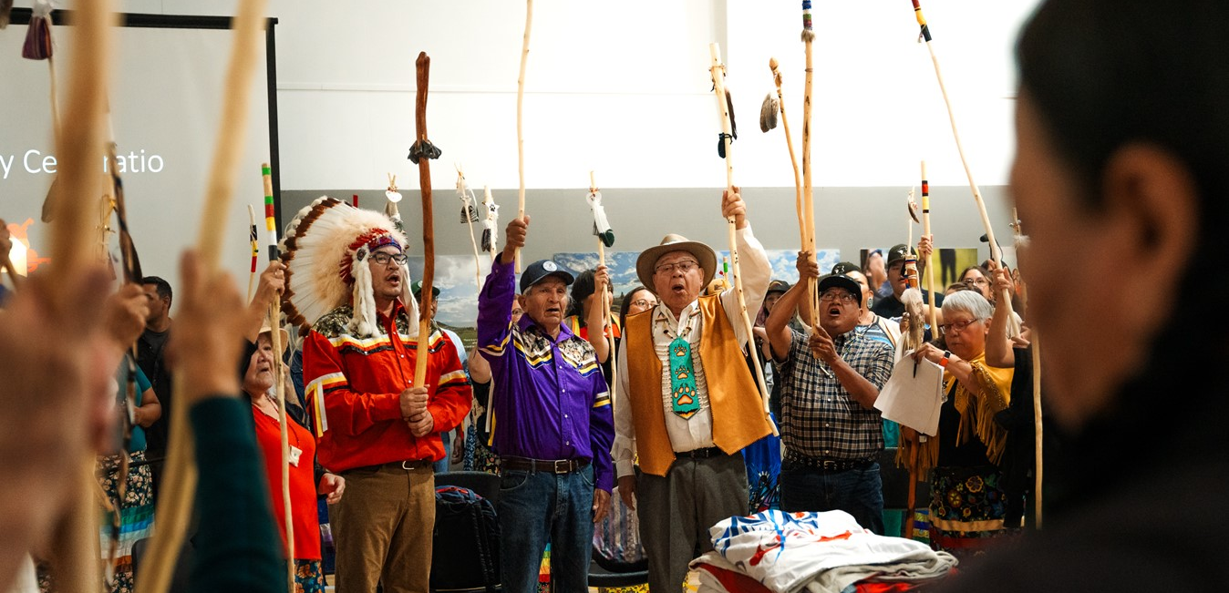
510 Yes Votes
5 No Votes. 13 Spoiled Ballots.

Slide 7
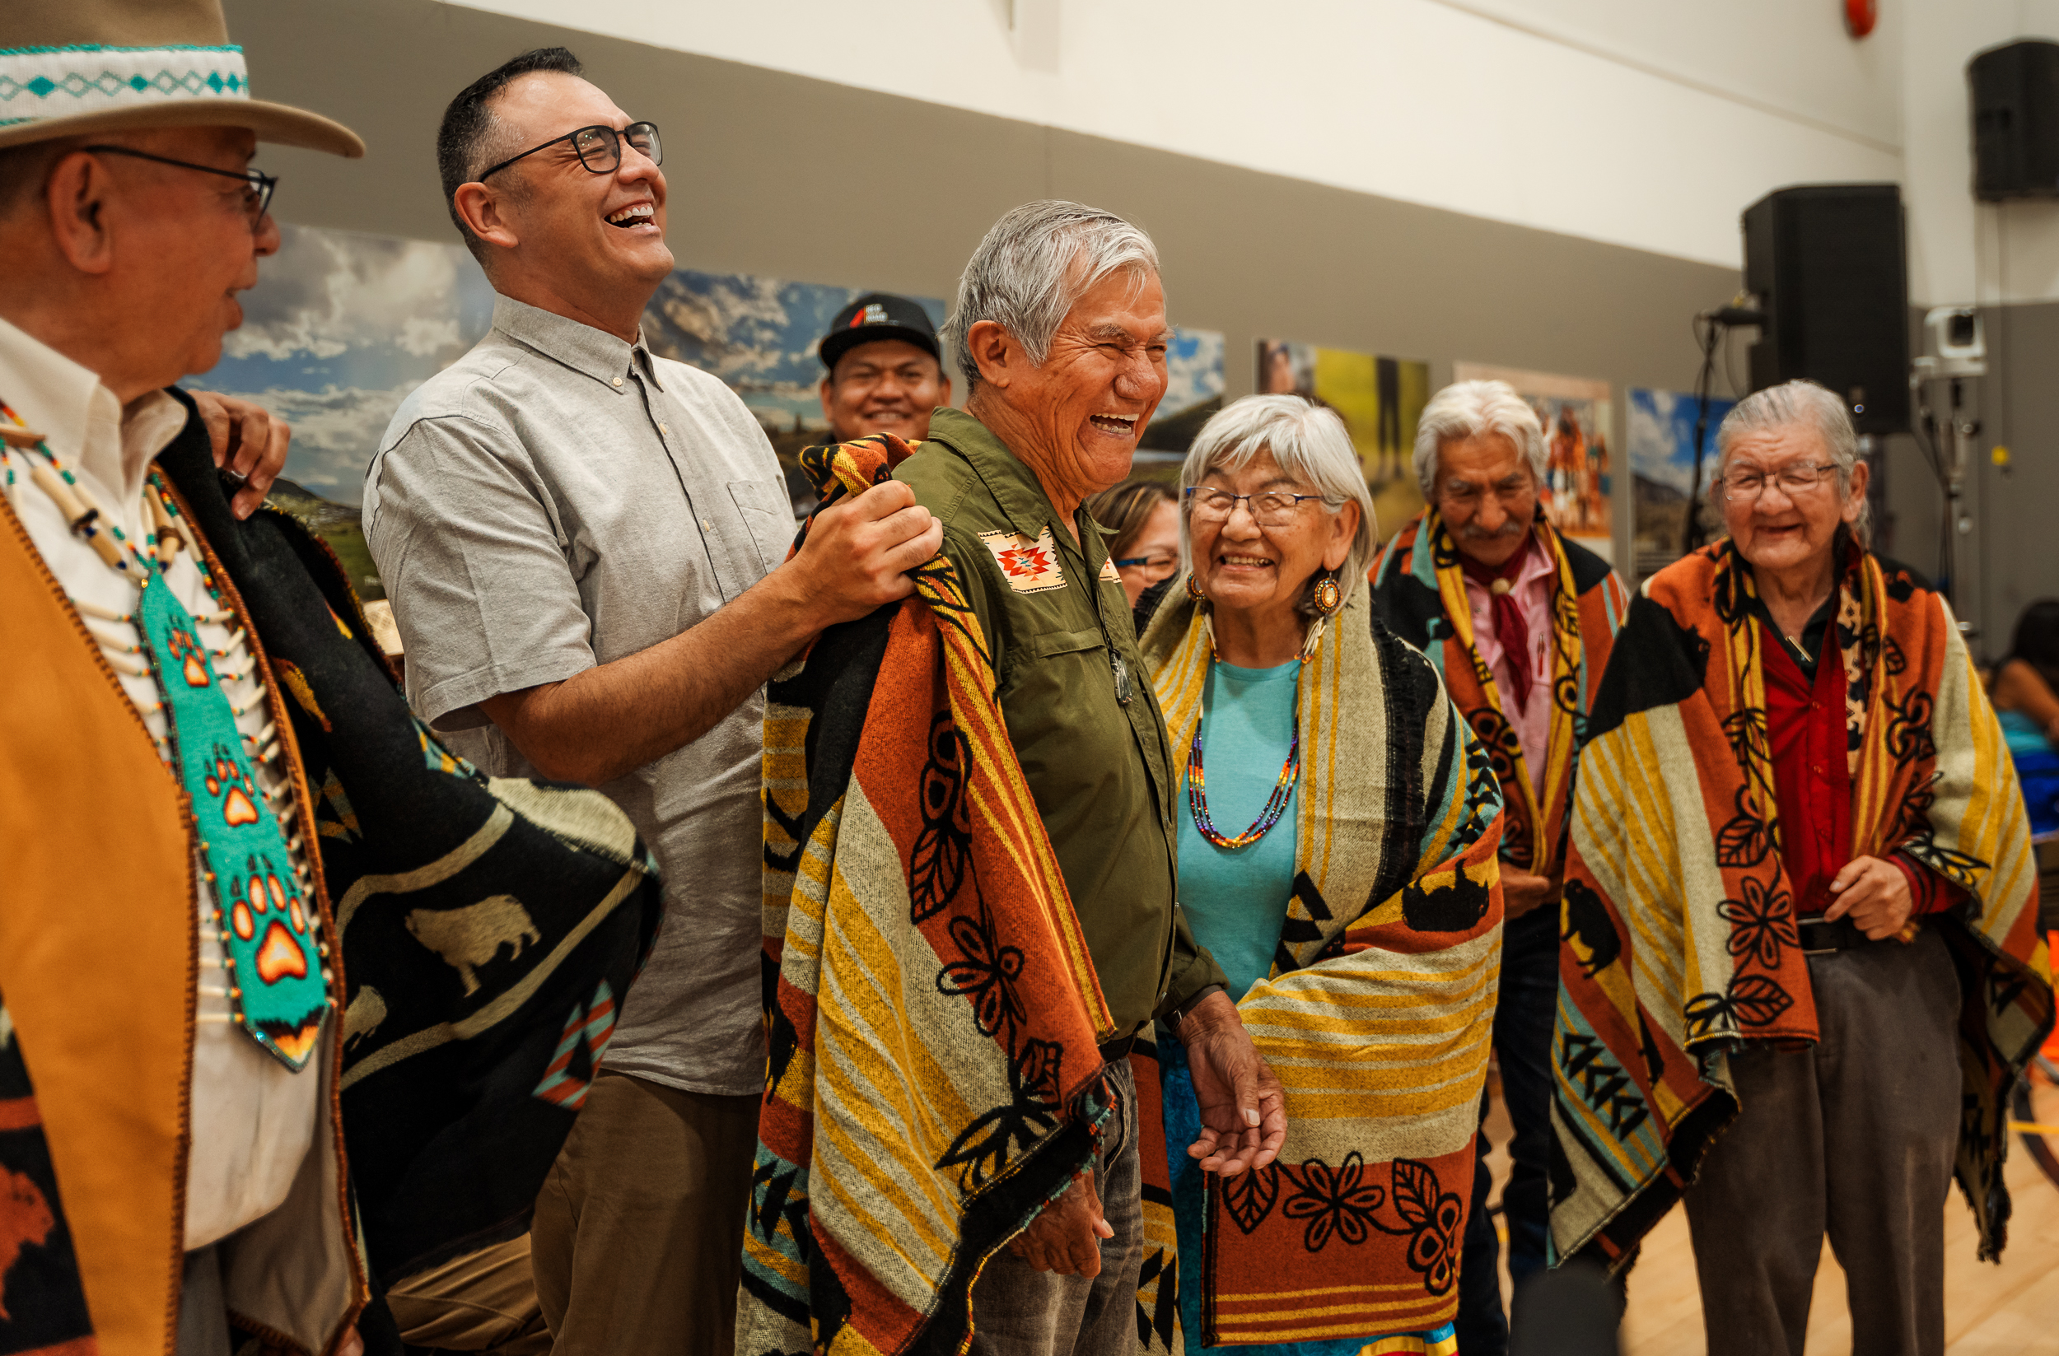
Esk’etemc Victory Celebration

Slide 8
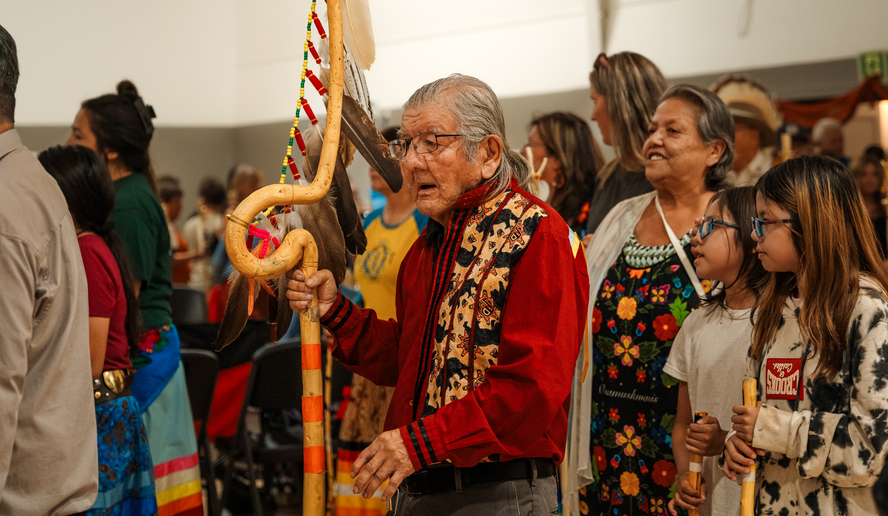
Kukstsémc

