Slide 1
Gender-based Analysis Plus (GBA Plus) & Specific Claims
Amanda Fletcher, Manager, CIRNAC GBA Plus Centre of Expertise
Heather Burton, Policy Analyst, Specific Claims Branch
November 5, 2024

Slide 2
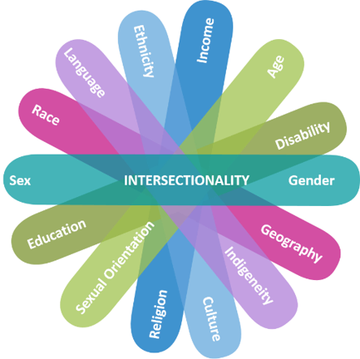
What is GBA Plus?
A powerful analytical process that helps build considerations of diversity and inclusion into Government of Canada initiatives.
Takes into consideration intersecting identity factors beyond gender (race, geography, disability, age, etc.), as well as systems of oppression, and power dynamics.
GBA Plus should be considered at every stage of an initiative’s lifecycle – from identifying the issue and developing options, all the way to implementation and evaluation.

Slide 3
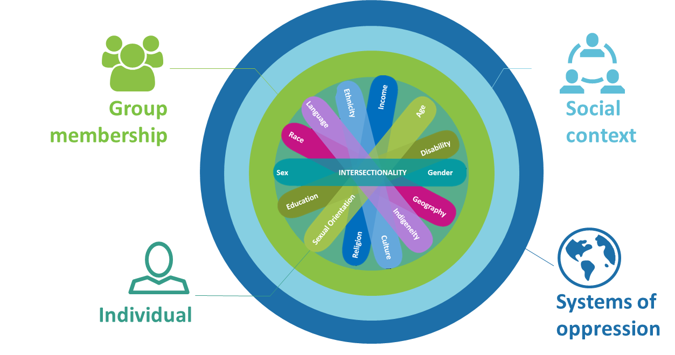
GBA Plus Considerations for a Systemic and Holistic Analysis of Inequity
Family, peer groups, social networks
Institutions, privilege, attitudes, norms, beliefs
Race, Ethnicity, Religion, Age, Disability, Gender, Geography, Language, Income, Sexual orientation, Education, Sex
Racism, sexism, ableism, ageism, classism, religious oppression, bi-phobia, transphobia, homophobia, heterosexism, distribution of resources and power

Slide 4
Common Principles of Culturally Competent GBA Plus
Be distinctions-based and acknowledge the unique historical, cultural, political, and socio-economic realities of First Nations, Inuit, and Métis;
Be informed by the unique perspectives, lived experiences, and worldviews of First Nations, Inuit, and, as well as by communities within these distinctions;
Take an anti-racist approach and acknowledge colonialism, patriarchy, and systemic racism, as well as the diverse impacts these structures and systems have on Indigenous Peoples;
Recognize that the gender binary is a colonial construct and understand that gender is socially and culturally constructed, respecting the lived realities of 2SLGBTQI+ people;
Build initiatives on communities’ strengths rather than focusing on challenges;
Value both Indigenous knowledges as well as Western knowledge; and,
Undertake intersectional analyses in respectful partnership with Indigenous Peoples, mindful of self-determination.

Slide 5
Standards of a Strong, Culturally Competent GBA Plus
Includes a basic demographic profile of impacted population(s).
Takes an intersectional approach to identifying impacts (consideration of multiple identity factors including disability, geography, distinctions, gender, age, income, etc.)
Consideration of how systemic issues (colonialism, racism, cultural assimilation, patriarchy) shape how impacted populations experience an issue.
Understands that CCGBA Plus can apply at the community level, and not always at the individual level.
Efforts taken through the program design to minimize barriers to access and mitigate negative impacts on impacted population(s).
CCGBA Plus incorporated throughout reporting and Cabinet documents.
Complies with requirements of the Canadian Gender Budgeting Act to report on gender & diversity results.
Uses disaggregated data specific to the impacted population to inform program design and implementation.
Incorporate Culturally Competent GBA Plus and address data gaps via the utilization of innovative approaches (e.g.: qualitative data)

Slide 6
Key Considerations for Culturally Competent GBA Plus (1 of 3)
Distinctions-based | Avoid pan-Indigenous language, provide data to describe the unique contexts, perspectives, priorities, needs, barriers and impacts for each group, as well as address distinctions within distinctions (e.g. status/non status, on/off reserve, etc.).
Gender Diversity | Use gender-inclusive language, acknowledge gender as a continuum and consider/provide data to describe the unique contexts, perspectives, priorities, needs, barriers and impacts for people of all genders.
Intersectionality | Consider broad and intersecting characteristics and factors to conduct analysis such as identity (e.g. race, age, ability, sexuality, gender), geography (e.g. urban, rural, remote, northern, etc.), socioeconomic (e.g. education, income, household composition, etc.) and systemic (e.g. intergenerational trauma, historical systemic inequities, systems of oppression, etc.).

Slide 7
Key Considerations for Culturally Competent GBA Plus (2 of 3)
Strengths-based | Build upon target population strengths, acknowledge barriers, place accountability on systems and structures of power (e.g. colonialism, patriarchy, etc.) and avoid language that targets individual characteristics (e.g. framing people as “vulnerable” or “low capacity”).
Intergenerational Impacts | Consider how conditions will improve for future generations, connections will be supported, and knowledge transmission will occur between generations (e.g. youth and Elders), and whether this will contribute to interrupting systemic issues (e.g. cycles of violence).
Engagement | Highlight how engagement and co-development is inclusive of diverse voices (e.g. NIOs, NIWOs, regional partners, community partners, etc.), and how these voices will inform the proposal and data collection strategy. Note what accessibility and cultural competency measures were applied during engagements.

Slide 8
Key Considerations for Culturally Competent GBA Plus (3 of 3)
Data integration | Utilize a broad range of recent data sources including qualitative and Indigenous Knowledges to describe context, anticipated impacts and to inform the development of clear measures to monitor and evaluate impact. Address bias within and toward Eurocentric approaches and methodologies.
Utilize and link to key reports | Draw upon key reports (e.g. MMIWG Final Report and Calls to Justice, TRC Reports and Calls to Action, UNDRIP, Federal 2SLGBTQ+ Action Plan, etc.) for data and make links whenever possible to specific calls.
Self-determination | Utilize language that is rooted in a respect for self-determination, highlight how the proposal practically reinforces self-determination (e.g. promotes application of Indigenous ways of being, doing and knowing) and links to the department’s mandate for a nation-to-nation relationship.

Slide 9
CIRNAC’s approach to Culturally Competent GBA Plus
.
There are many novel and creative ways in which programs can meet GBA Plus requirements without imposing on Indigenous partners. For example:
Process metrics.
Qualitative impact reporting, including:
Use of Indigenous-owned data with permission, ex: Nisga’a Household Survey, Inuit Health Survey.
Using publicly available data and academic research.
Co-developing CCGBA Plus data or analysis plans with partners.
Using CCGBA Plus frameworks developed by Indigenous partners (NWAC, Pauktuutit, LFMO).

Slide 10
Culturally Competent GBA Plus - Common Pitfalls
Assuming GBA Plus in just the annex to an initiative.
Claiming an initiative will have “no GBA Plus impacts” or will affect all “equally”.
Only focusing analysis on gender, with no mention of other intersectional identity factors.
Doing GBA Plus at the end of the initiative development and/or using it to justify an initiative.
Failing to acknowledge data gaps or failing to consider specific groups because of lack of data.
Claiming that GBA Plus can not be conducted because of Indigenous self-determination.
Failing to reflect GBA Plus findings in options and recommendations.
Not engaging impacted communities to gather diverse perspectives.

Slide 11
CCGBA Plus & Specific Claims Introduction
Indigenous women, 2SLGBTQQIA+ people, and other groups are all uniquely impacted by Specific Claims:
For example, reserve creation processes carried out by colonial and Dominion officials in the 19th and 20th centuries had profound impacts on the political, economic, and social power of Indigenous women.
There is a need to better understand the colonial suppression of women’s authority and economies, and how reconciliation considers the gendered nature of colonial harms in the context of specific claims
.

Slide 12
CCGBA Plus & Specific Claims
Challenges
GBA Plus is not enshrined in the Specific Claims policy or legislation
the specific claims process is gender-neutral
archival evidence of women’s voices and authority are scarce
there are limitations to collecting and monitoring data
Further efforts are still needed to have conversations with Indigenous partners about GBA Plus to identify potential opportunities to build inclusive gender and diversity considerations into any co-developed initiatives.

Slide 13
CCGBA Plus & Specific Claims Interim Process metrics
During the summer of 2024, CIRNAC explored publicly available data sets that could help inform ways in which to improve and integrate CCGBA Plus into the program:
First Nations Profile: This data details governance structures, geographic remoteness and disaggregated population data for First Nation members on and off reserve, and by gender.
Specific Claims Public Reporting Interface: the Specific Claims Branch maintains a public database which includes data such as the number claims settled by Province/Territory.
Community Wellbeing Index: measures socio-economic well-being using 4 components: education, labour force activity, income and housing

Slide 14
Specific Claims Reform Considerations for improvement
How can a reformed process support diversity and the inclusion of First Nations cultures, traditions, knowledges and lived experiences?
Reform:
provides an opportunity to promote a ‘hard-wiring’ of Culturally Competent GBA Plus principles into the ongoing co-development work on Specific Claims reform
For example, continuing to explore and make space for the inclusion of Indigenous laws and legal traditions throughout the resolution process
provides opportunities for Canada and First Nations or a new Centre to explore a more effective process informed by GBA Plus throughout a claim’s lifecycle:
Development
Review
Negotiations
Settlement

Slide 15
Miigwech | Merci | Thank – you

