Slide 1
Land Use & Occupancy Claim

Slide 2
Flat Bay/St. George’s Youth
Drummers & Dancers
Canada Day Celebration
1990s
Naming Ceremony Chief Bill Joe
Chief Don Marshall (Grand)
Chief Bill Joe
Calvin White
Jerry Wentzell
1975

Slide 3
•The earliest visitors to Bay St. George recorded Indian occupation at various locations in Flat Bay.
•Flat Bay was the description given to the sheltered water inside the peninsula identified as Sandy Point, now referred to as St. George’s Harbour. It was in the early 1800’s when a land base was given the name Flat Bay as it exists today.
•Its population was a collection of Mi’kmaq families who moved in close proximity to each other, mainly due to European encroachment on Mi’kmaq traditional family territory. A few families remained in location other than Flat Bay Village, however many moved away from the area to the South Coast in places such as Conne River, White Bear and Grandy’s Brook.
•Flat Bay Village was ideally located in an isolated area borded by Flat Bay River to the East, Fischell’s River to the West, the ocean to the North (fishing grounds) and 90 miles of wilderness to the South (hunting and fishing territory).
•Flat Bay Mi’kmaq traded and bartered with these new neighbors and carried out a traditional lifestyle. In the 1930’s, Mi’kmaq offered their services to logging companies and provided guiding services from the first European interior travel (WE Cormack 1822).
•From its origin until 1970, well after Confederation (1949), Mi’kmaq and Flat Bay lived under a traditional system of government. In 1972, due to European pressure and imposed changes to lifestyle, a new form of governance was adopted, which included a democratic election of Chief and Council, same traditional structure, a new system of process and added responsibilities of modern-day services such as garbage collection and water services. For the past 47 years, we have avoided colonial dictatorial government, one where policies are developed and passed down by imposing them on people. Our system originates from the people and is carried out by Council. We have no desire to abolish what has worked for hundreds of years.
FLAT BAY BAND INC
INTRODUCTION
Dr. Elder Calvin White

Slide 4
The Difference Between
Flat Bay Band
and
Qalipu First Nations Band
Our introduction would be incomplete if we didn’t address the difference between Flat Bay Band and Qalipu First Nations Band. Qalipu is an Indian Act band created by the application of Bill C-25 and an agreement in principle between the Federation of Newfoundland Indians and the Government of Canada. However, later a supplementary agreement was added without member consultation or approval. Membership was determined by a point system. Its design saw twins separated, one registered as Indian and the other not. People who left their community for education, employment or to serve their country in the services, including RCMP, were also denied. Flat Bay Band is an independent band and has 4th Generation Rule, pre-confederation documents required to determine its membership. Out of a population of approximately 1200, only 140 people were accepted. Qalipu is a landless band and does not represent any other band. It represents its membership, that is people who are registered as status Indians under the creation of the Qalipu Band. Flat Bay Band has historically represented its people since community creation. For hundreds of years, a village form of governance existed. In 1972, we first adopted Indian Act model elected chief and council by universal suffrage. Never have we accepted provincial, municipal or local service district governance. We were never consulted at the time Newfoundland entered Confederation. It was 1969 when we were made aware of Canada’s constitutional responsibility to First Nation people. Due diligence was never on the table and Flat Bay awaits in meaningful negotiation. Our position: We are Mi’kmaq Treaty people, We are Federal Government Constitutional responsibility 91 (24), We have a specific land claims dating back to Newfoundland’s entry into Confederation when land should have been negotiated for colonial community occupation, We are members in good standing of the Assembly of First Nations since the year 2000, and We are self-governed people without Indian Affairs funding or provincial support. We have become criminals for foraging on our lands and in our waters. The time has come for Canada to treat us as Treaty Holders with Specific Land Claims and access to all the responsibilities in the Canadian Constitution with regard to its aboriginal population.

Slide 5
Evidence Of An Appeal
Judy White, Acting Chief 1997

Slide 6
Points Of Specific Claim

Slide 7
List of Past Mi’kmaw Guides In Bay St. George, NL
Paul Benoit of Peter Flat Bay 1856-1921
Peter Benoit Flat Bay 1833-1920
Noel Bernard Mattis Point 1842-1902
Louis Gabriel Codroy Valley 1800-1822
Louis Gabriel Codroy/Stephenville 1858-1924
Noel Joe Seal Rocks/Mattis Point 1832-1922
Frank King St. Teresa’s 1872-1947
Thomas Webb Flat Bay 1866-1927
Joseph Young St. Teresa’s 1851-1919
Maxim Young Flat Bay 1851-1935

Slide 8
Mi’kmaw Guides
Pre/Post Confederation
Descendants of Guides Listed

Slide 9
The 1945 Census
4th Generation Rule
*A person must be a descendant of the following who identified as being Indian
pre-confederaion:
*parent
*grandparent
*great grandparent
*great great grandparent
Elizabeth Halbot Legge
July 5, 1910 - September 11, 1953
Descendant of Mi’kmaq woman Modeste Bernard
of Cape Breton, NS who moved to Sandy Point, NL and married Francois Halbot.
261 Residents identified as Indian on the 1945 Census. The 1945 Census was the first census providing a column for ‘’Racial Origin’’ allowing those 261 people the opportunity to identify.

Slide 10
Sir
Jinot Piquid Oulat & Bernard, Chiefs of the Mickmack Indians
of Cape Breton, being on board his Majesty’s Ship Lark under
my Command, when off the Island of Codroy, in September
last to renew a treaty of Peace with his Majesty, a Copy
whereof I have already sent you, they then begg’d of me, on
my return to Newfoundland, to bring them Things mention’d
on the other side, which if their Lordships would permit, I
promised to do; I therefore desire you may be pleased to
inform me, whether the Government will supply these Indians
with said things, or whether they will allow me to carry them to
them, as I should be glad to have it in my Power to perform
my Promise. I am.
Sir
Your most obedient
& very humble Servant
Sam Thompson
Philip Stephens Esq. Secretary to the Admiralty
Larks Apr. 16th, 1764
Inventory of the Things ask’d for by the Mickmack Indian Chiefs
Coarse blue Cloath___________________________ Yards
Powder ___________________________________ 100 Pounds
Small Shot _________________________________ 200 Doz
Copper Kettles ______________________________ Six in No.
Musquets __________________________________ Ten
Hatchets ___________________________________Twenty
Puffed Shirts ________________________________Ten
Checqued Shirts _____________________________ Twenty
Green Coats with a narrow edging for men
about 5 feet 8 In. high _________________________ Two
Gold Lac’d Hatts _____________________________ Three
Cod Lines __________________________________ Twelve
Salmon Netts ________________________________ One
Sea Compass for a Shallop _____________________ One
Red Waistcoats with broad Lace _________________ One
Lanthorns ___________________________________ One
Graplines for a Shallop _________________________ One
Some red, green & white ribbons and as much Canvas and Twine as
will be sufficient to make sails for two Shallops.
Sam Thompson
Evidence: Treaty People

Slide 12
Confirmation of Flat Bay Band’s Acceptance in Assembly of First Nations July 13, 2000

Slide 13
Building A Way Forward.......

Slide 14
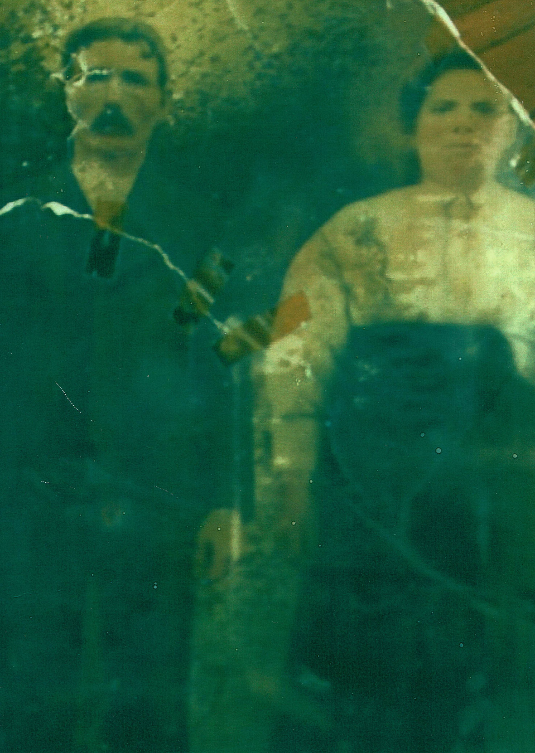
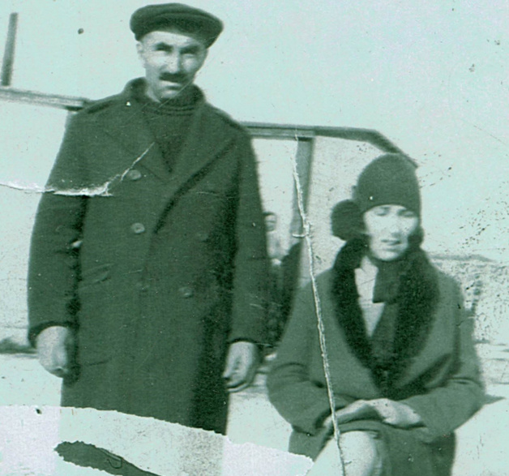
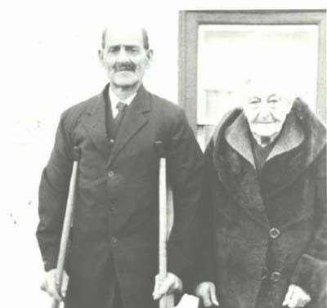
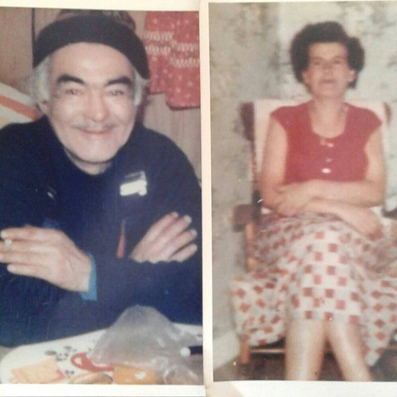
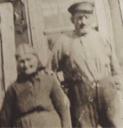
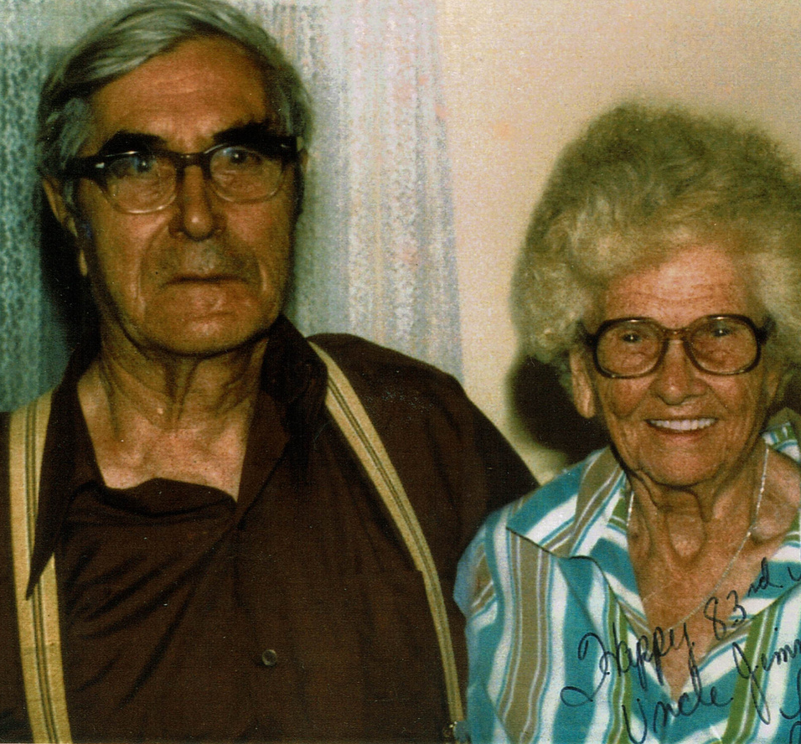
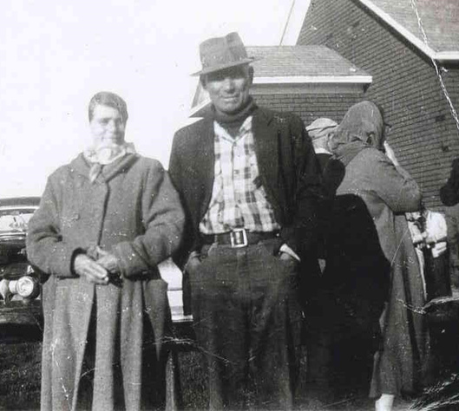
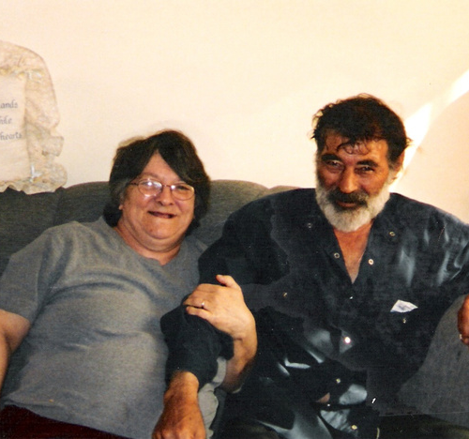
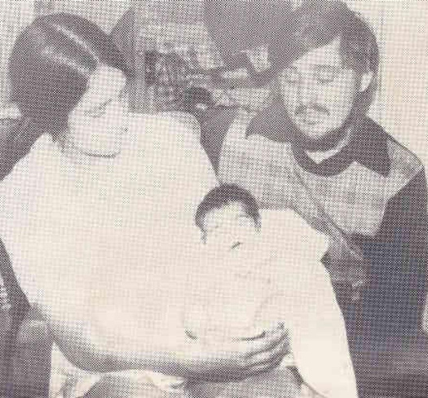
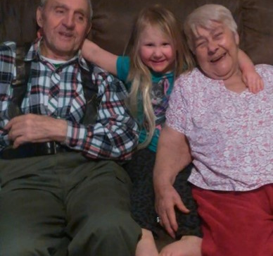

Slide 15
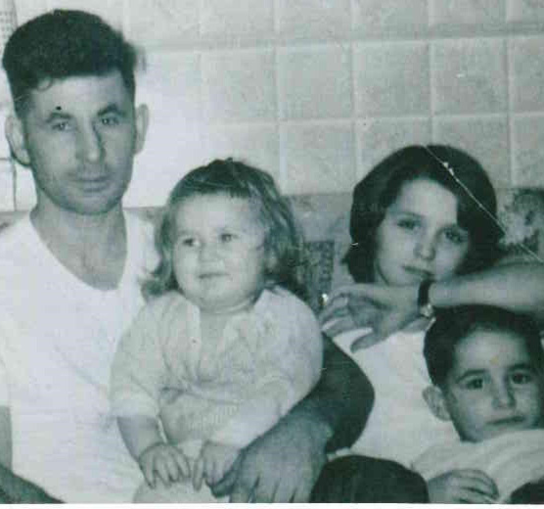
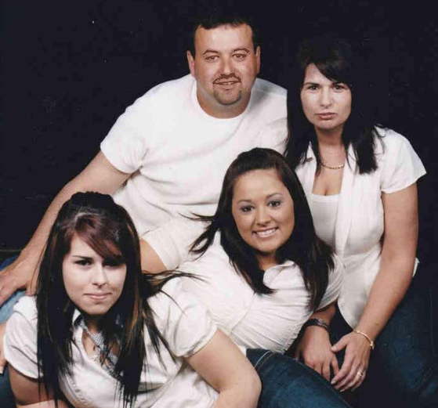
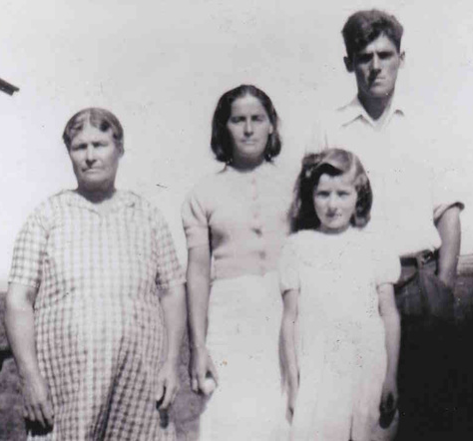
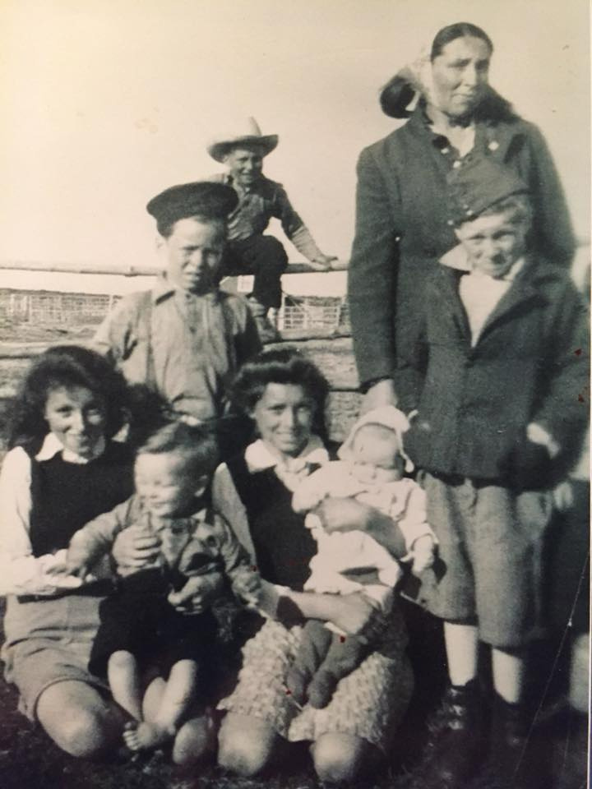
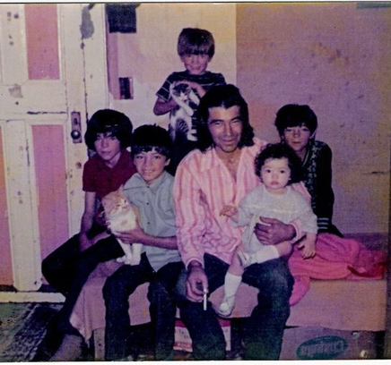
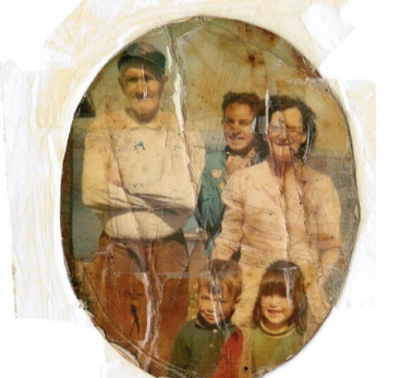
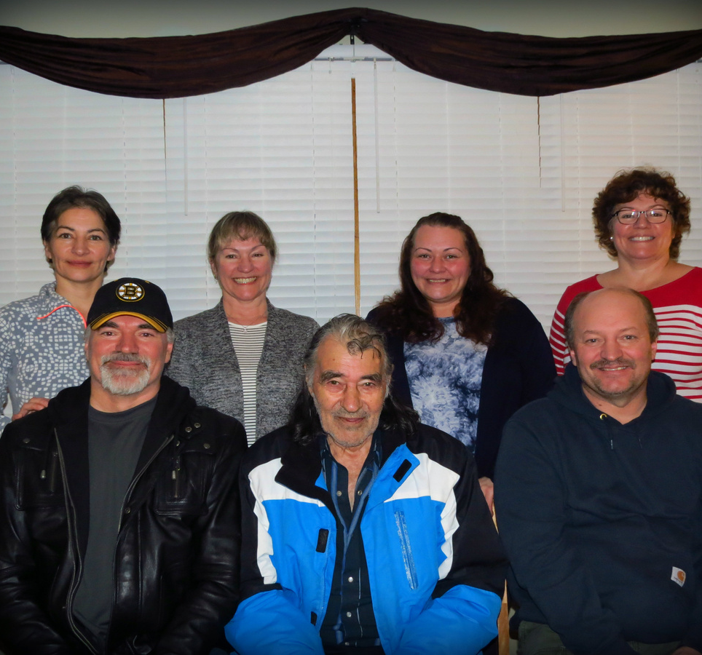
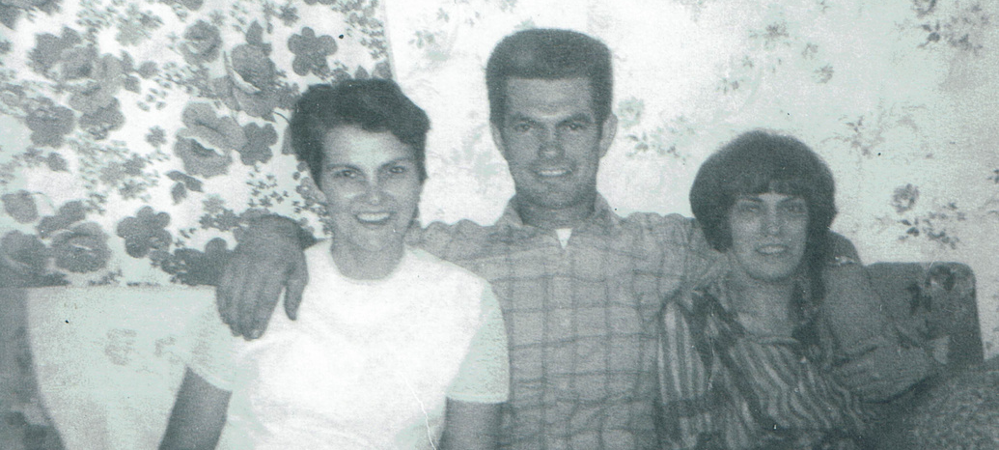
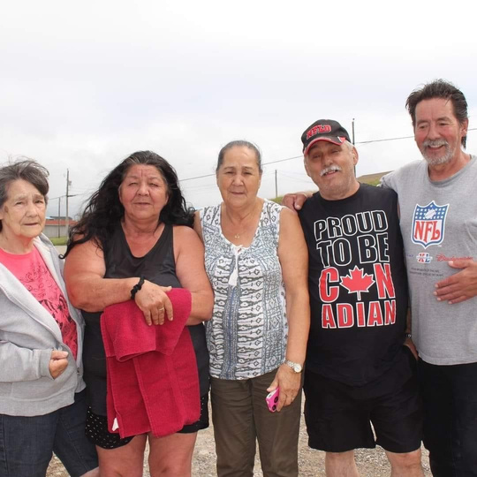
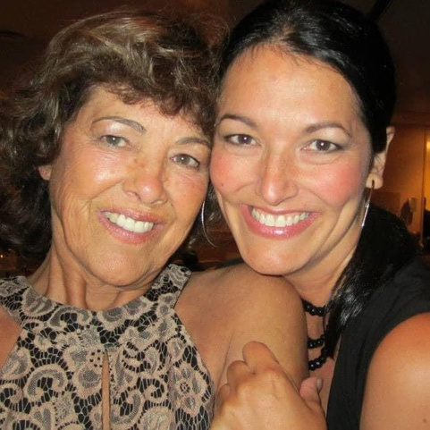
Families from 1890-Present
All families confirmed in
the 1945 Census

Slide 16
Nukumij (My Grandmother)

Slide 17
Niskamij (My Grandfather)

Slide 18
Gathering

Slide 19
Flat Bay Way Of Life

Slide 21
Flat Bay School Children Pre 1949 Confederation

